Slide 1
Coupledline Compiled Data

Slide 2
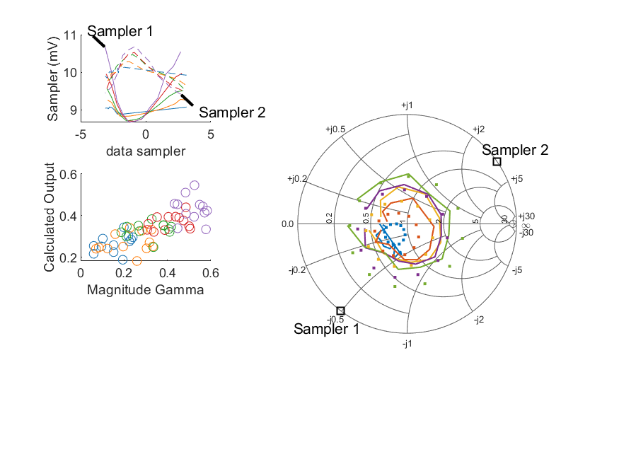
Coupled Line Performance At 10.60 GHz, 16.000000 dBm Output Power 1.00 V mean sampler bias
Sampler Av
Sampler 1: 237.336
Sampler 2: 300.000
Sampler Offset (rather than -1)
-5.0668952047004909
Sampler 1 Range
0.00199
Sampler 2 Range
0.00128
DUT output dBm Mean
15.97700
DUT input dBm Mean
16.53687
RMS Error
0.10272

Slide 3
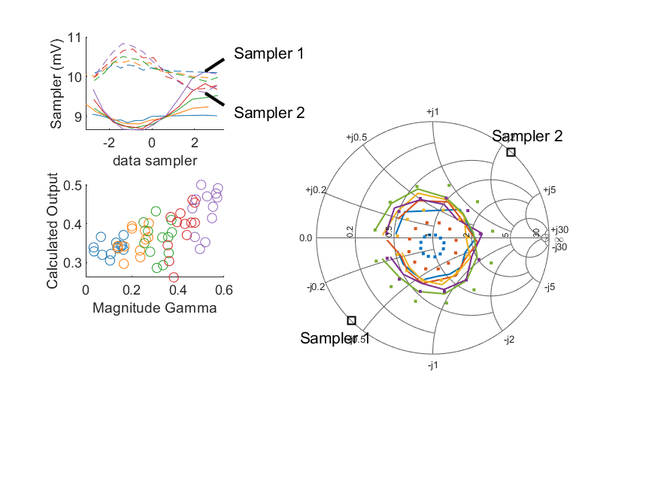
Coupled Line Performance At 10.70 GHz, 16.000000 dBm Output Power 1.00 V mean sampler bias
Sampler Av
Sampler 1: 237.336
Sampler 2: 300.000
Sampler Offset (rather than -1)
-5.0668952047004909
Sampler 1 Range
0.00146
Sampler 2 Range
0.00123
DUT output dBm Mean
16.00637
DUT input dBm Mean
16.43286
RMS Error
0.13795

Slide 4
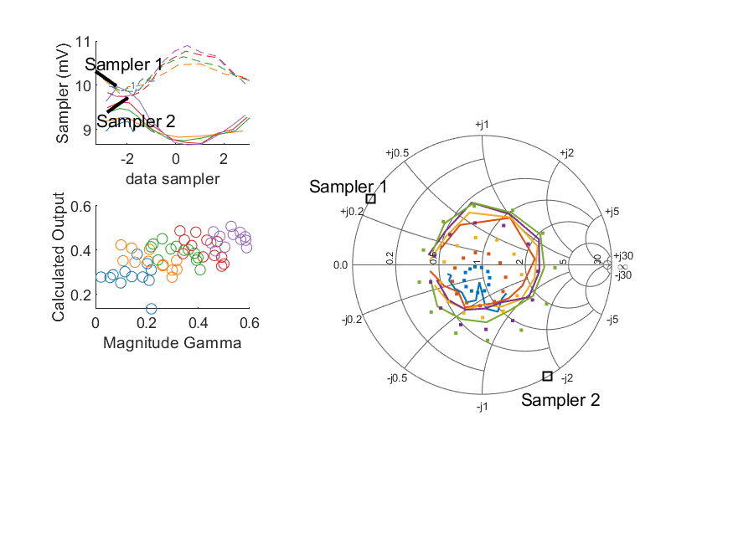
Coupled Line Performance At 10.80 GHz, 16.000000 dBm Output Power 1.00 V mean sampler bias
Sampler Av
Sampler 1: 237.336
Sampler 2: 300.000
Sampler Offset (rather than -1)
-5.0668952047004909
Sampler 1 Range
0.00131
Sampler 2 Range
0.00116
DUT output dBm Mean
15.99252
DUT input dBm Mean
16.44173
RMS Error
0.13441

Slide 5
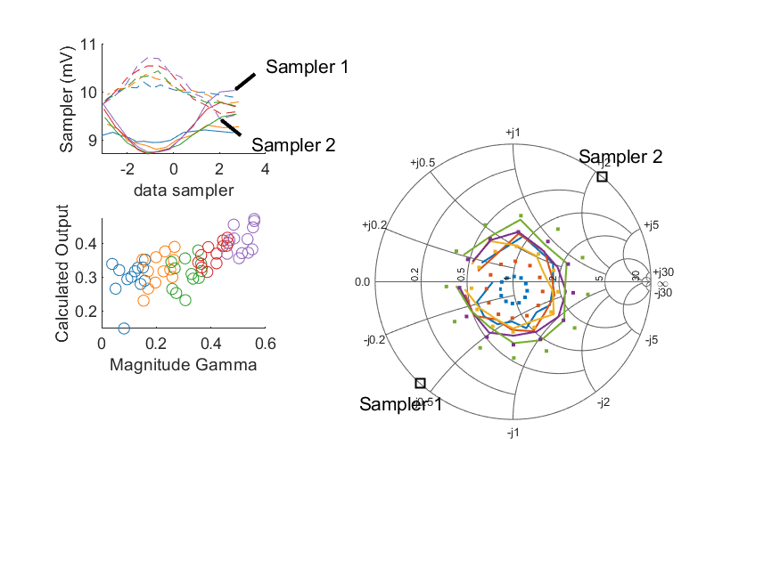
Coupled Line Performance At 10.90 GHz, 16.000000 dBm Output Power 1.00 V mean sampler bias
Sampler Av
Sampler 1: 237.336
Sampler 2: 300.000
Sampler Offset (rather than -1)
-5.0668952047004909
Sampler 1 Range
0.00132
Sampler 2 Range
0.00127
DUT output dBm Mean
15.98133
DUT input dBm Mean
16.50231
RMS Error
0.11880

Slide 6
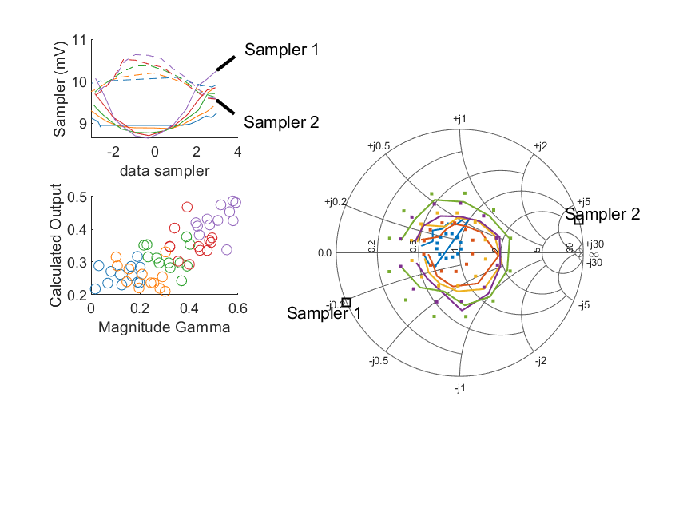
Coupled Line Performance At 11.00 GHz, 16.000000 dBm Output Power 1.00 V mean sampler bias
Sampler Av
Sampler 1: 237.336
Sampler 2: 300.000
Sampler Offset (rather than -1)
-5.0668952047004909
Sampler 1 Range
0.00160
Sampler 2 Range
0.00106
DUT output dBm Mean
16.01625
DUT input dBm Mean
16.45544
RMS Error
0.10711

Slide 7
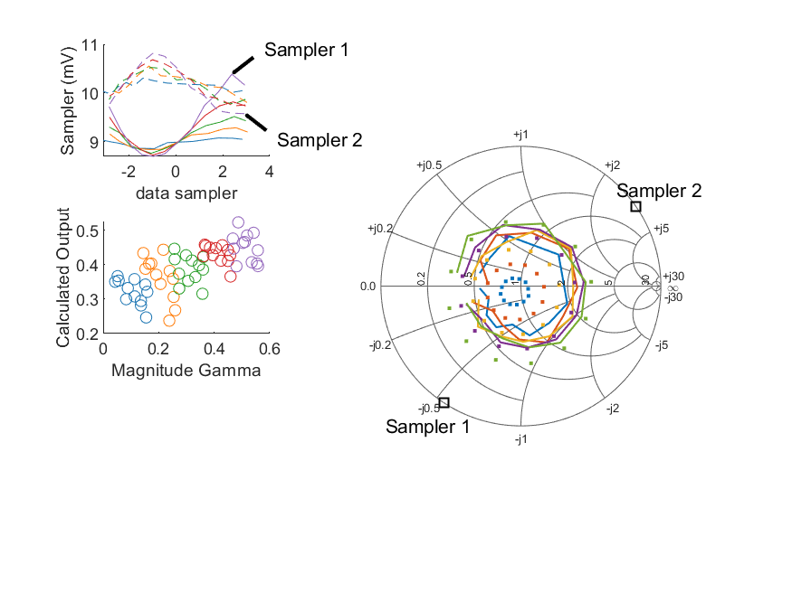
Coupled Line Performance At 11.10 GHz, 16.000000 dBm Output Power 1.00 V mean sampler bias
Sampler Av
Sampler 1: 237.336
Sampler 2: 300.000
Sampler Offset (rather than -1)
-5.0668952047004909
Sampler 1 Range
0.00169
Sampler 2 Range
0.00124
DUT output dBm Mean
16.03071
DUT input dBm Mean
16.51571
RMS Error
0.14368

Slide 8
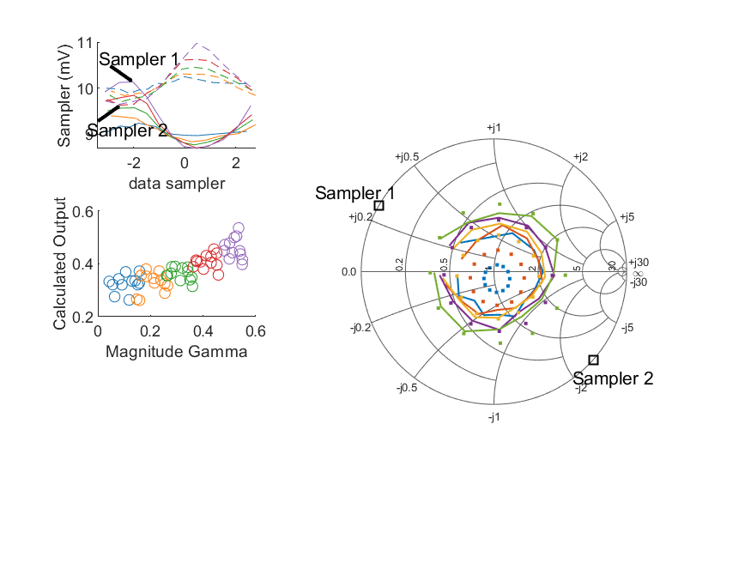
Coupled Line Performance At 11.20 GHz, 16.000000 dBm Output Power 1.00 V mean sampler bias
Sampler Av
Sampler 1: 237.336
Sampler 2: 300.000
Sampler Offset (rather than -1)
-5.0668952047004909
Sampler 1 Range
0.00145
Sampler 2 Range
0.00135
DUT output dBm Mean
16.01870
DUT input dBm Mean
16.53604
RMS Error
0.12520

Slide 9
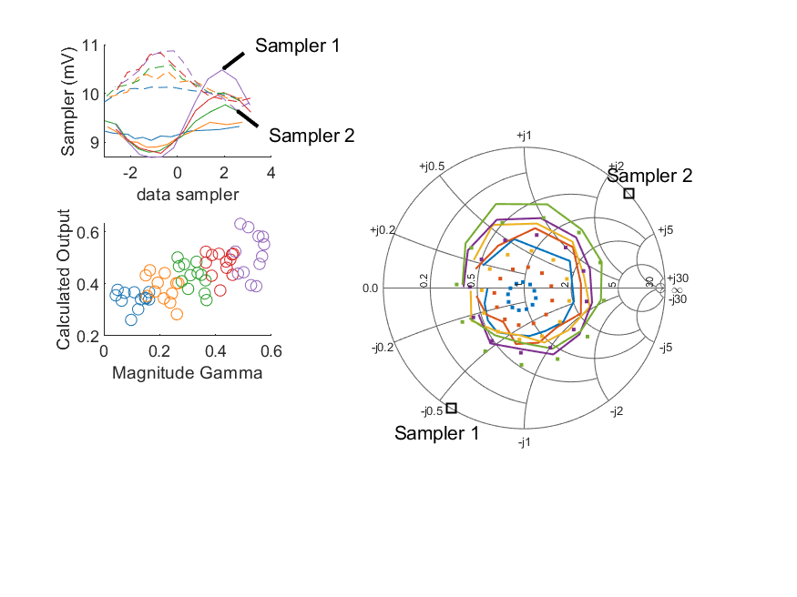
Coupled Line Performance At 11.30 GHz, 16.000000 dBm Output Power 1.00 V mean sampler bias
Sampler Av
Sampler 1: 237.336
Sampler 2: 300.000
Sampler Offset (rather than -1)
-5.0668952047004909
Sampler 1 Range
0.00180
Sampler 2 Range
0.00121
DUT output dBm Mean
16.01902
DUT input dBm Mean
16.52141
RMS Error
0.15670

Slide 10
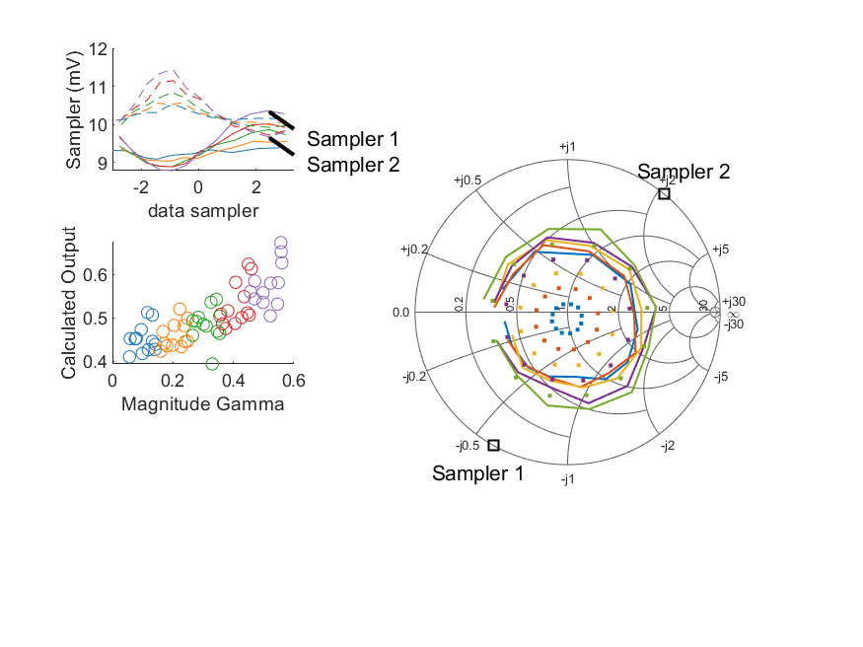
Coupled Line Performance At 11.40 GHz, 16.000000 dBm Output Power 1.00 V mean sampler bias
Sampler Av
Sampler 1: 237.336
Sampler 2: 300.000
Sampler Offset (rather than -1)
-5.0668952047004909
Sampler 1 Range
0.00157
Sampler 2 Range
0.00177
DUT output dBm Mean
16.08653
DUT input dBm Mean
16.59465
RMS Error
0.21820

Slide 11
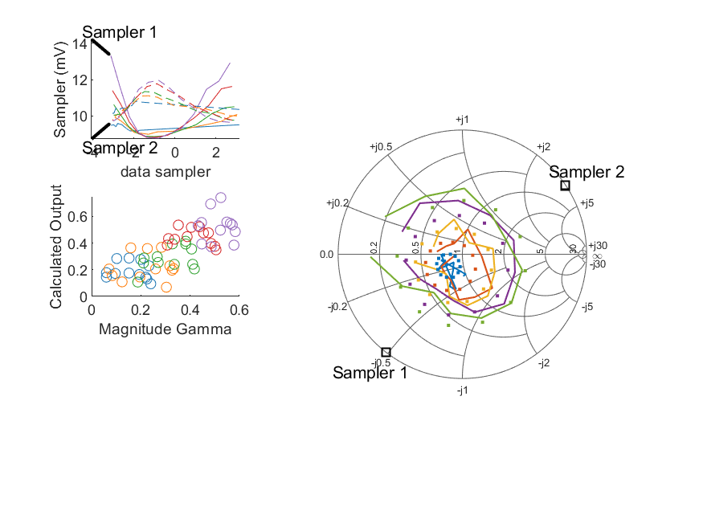
Coupled Line Performance At 10.60 GHz, 18.000000 dBm Output Power 1.00 V mean sampler bias
Sampler Av
Sampler 1: 186.820
Sampler 2: 262.115
Sampler Offset (rather than -1)
-4.4644800144133949
Sampler 1 Range
0.00452
Sampler 2 Range
0.00231
DUT output dBm Mean
17.95994
DUT input dBm Mean
18.52291
RMS Error
0.11865

Slide 12
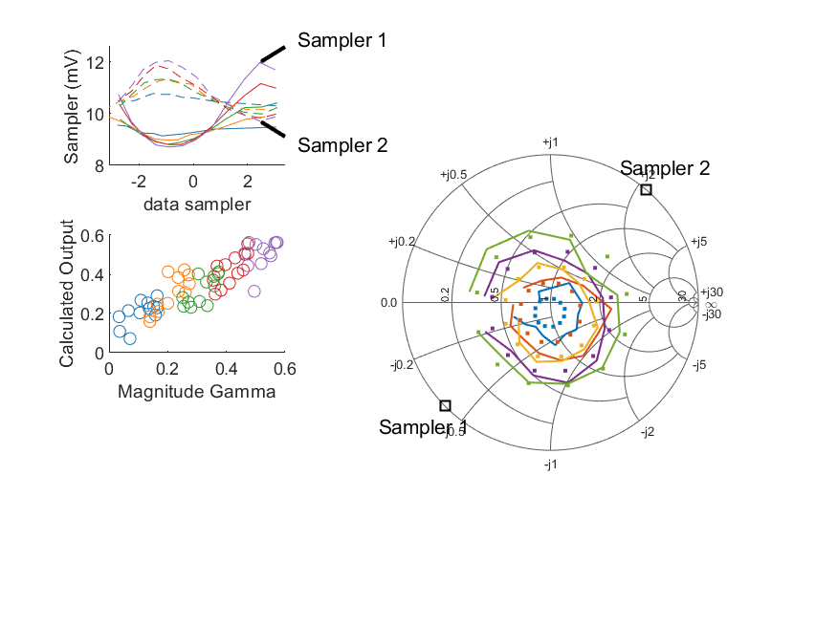
Coupled Line Performance At 10.70 GHz, 18.000000 dBm Output Power 1.00 V mean sampler bias
Sampler Av
Sampler 1: 186.820
Sampler 2: 262.115
Sampler Offset (rather than -1)
-4.4644800144133949
Sampler 1 Range
0.00326
Sampler 2 Range
0.00233
DUT output dBm Mean
17.98313
DUT input dBm Mean
18.41311
RMS Error
0.08089

Slide 13
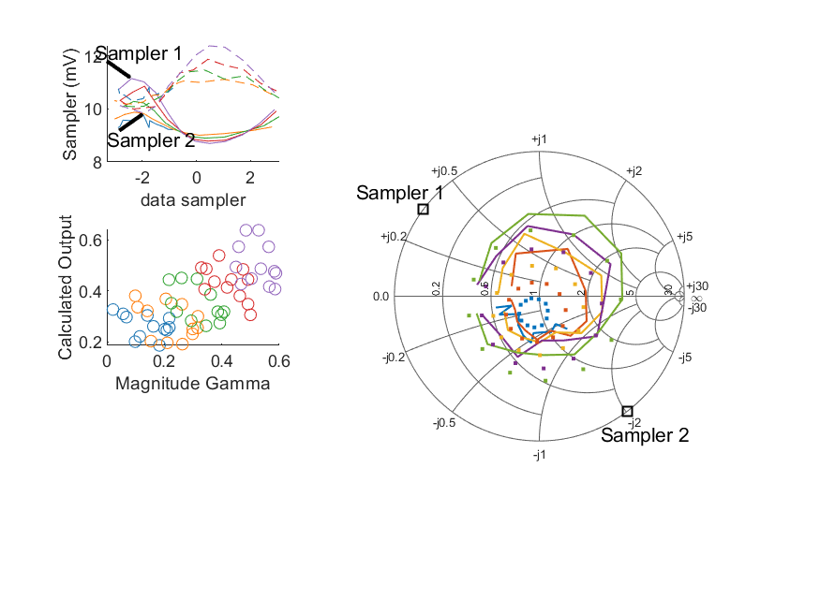
Coupled Line Performance At 10.80 GHz, 18.000000 dBm Output Power 1.00 V mean sampler bias
Sampler Av
Sampler 1: 186.820
Sampler 2: 262.115
Sampler Offset (rather than -1)
-4.4644800144133949
Sampler 1 Range
0.00246
Sampler 2 Range
0.00255
DUT output dBm Mean
17.97668
DUT input dBm Mean
18.43052
RMS Error
0.12575

Slide 14
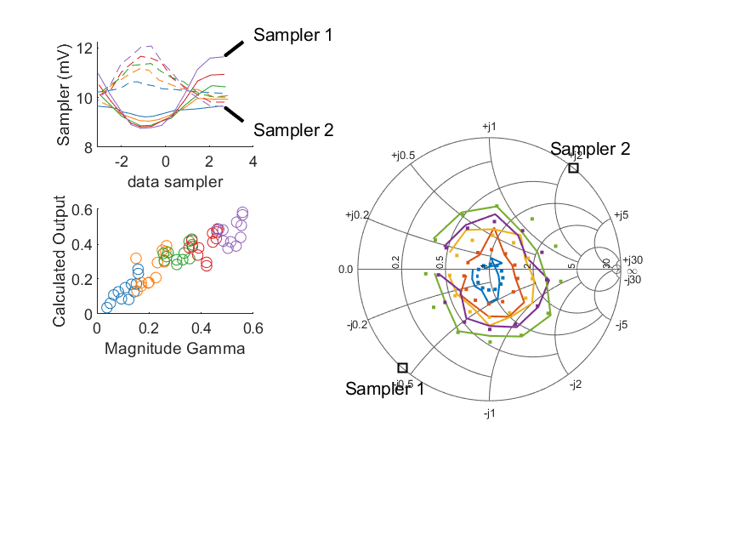
Coupled Line Performance At 10.90 GHz, 18.000000 dBm Output Power 1.00 V mean sampler bias
Sampler Av
Sampler 1: 186.820
Sampler 2: 262.115
Sampler Offset (rather than -1)
-4.4644800144133949
Sampler 1 Range
0.00287
Sampler 2 Range
0.00243
DUT output dBm Mean
17.96325
DUT input dBm Mean
18.48621
RMS Error
0.06615

Slide 15
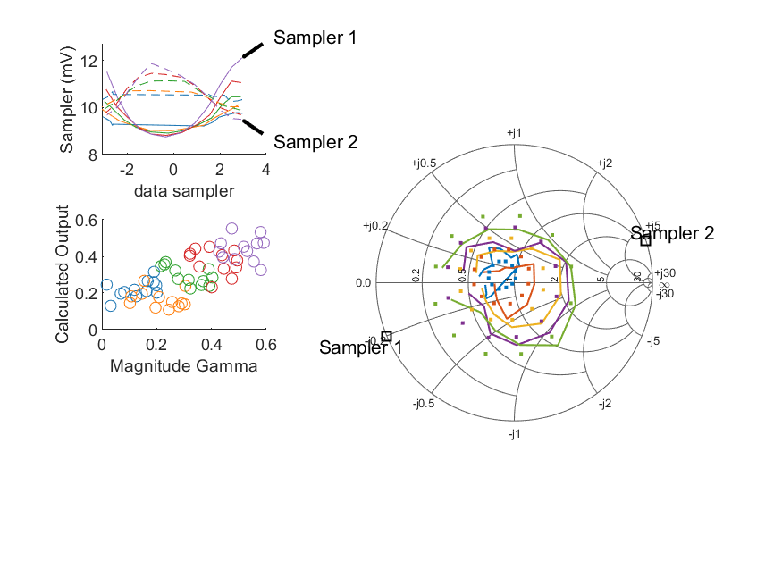
Coupled Line Performance At 11.00 GHz, 18.000000 dBm Output Power 1.00 V mean sampler bias
Sampler Av
Sampler 1: 186.820
Sampler 2: 262.115
Sampler Offset (rather than -1)
-4.4644800144133949
Sampler 1 Range
0.00335
Sampler 2 Range
0.00238
DUT output dBm Mean
17.99314
DUT input dBm Mean
18.43569
RMS Error
0.10913

Slide 16
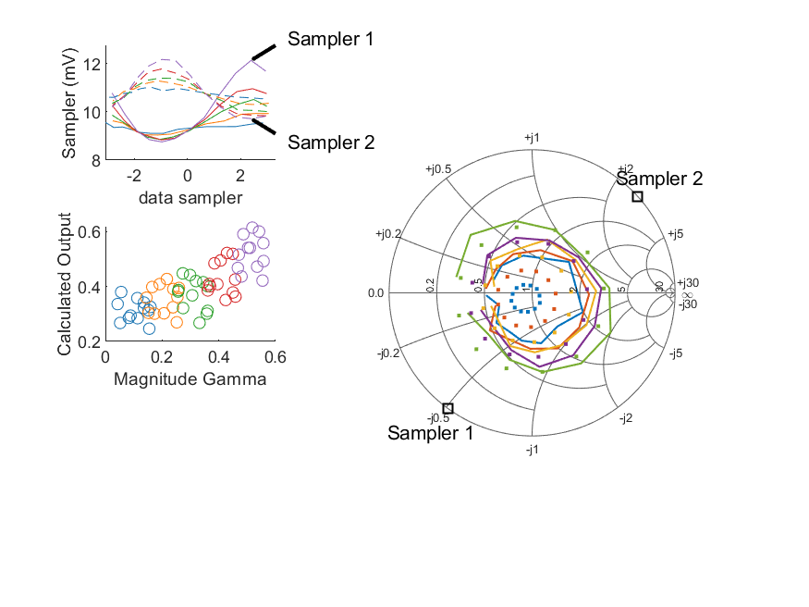
Coupled Line Performance At 11.10 GHz, 18.000000 dBm Output Power 1.00 V mean sampler bias
Sampler Av
Sampler 1: 186.820
Sampler 2: 262.115
Sampler Offset (rather than -1)
-4.4644800144133949
Sampler 1 Range
0.00338
Sampler 2 Range
0.00245
DUT output dBm Mean
18.00855
DUT input dBm Mean
18.49477
RMS Error
0.13414

Slide 17
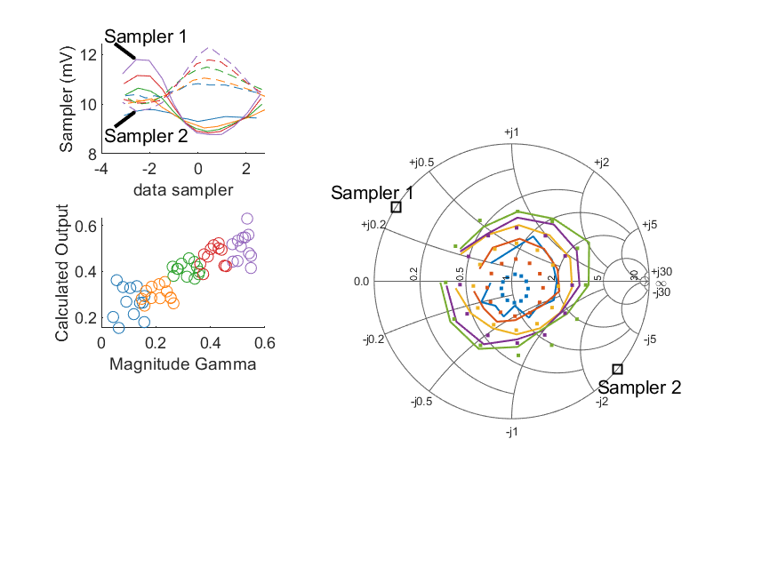
Coupled Line Performance At 11.20 GHz, 18.000000 dBm Output Power 1.00 V mean sampler bias
Sampler Av
Sampler 1: 186.820
Sampler 2: 262.115
Sampler Offset (rather than -1)
-4.4644800144133949
Sampler 1 Range
0.00302
Sampler 2 Range
0.00258
DUT output dBm Mean
17.97973
DUT input dBm Mean
18.49973
RMS Error
0.11055

Slide 18
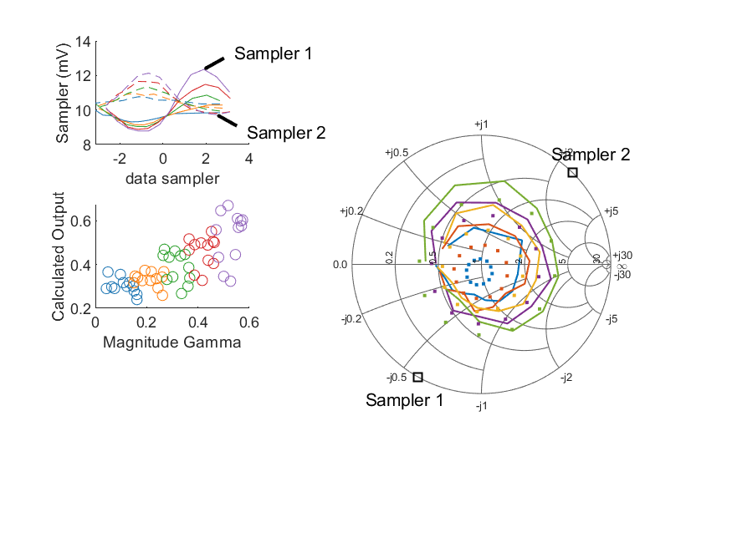
Coupled Line Performance At 11.30 GHz, 18.000000 dBm Output Power 1.00 V mean sampler bias
Sampler Av
Sampler 1: 186.820
Sampler 2: 262.115
Sampler Offset (rather than -1)
-4.4644800144133949
Sampler 1 Range
0.00357
Sampler 2 Range
0.00241
DUT output dBm Mean
17.99093
DUT input dBm Mean
18.49604
RMS Error
0.13361

Slide 19
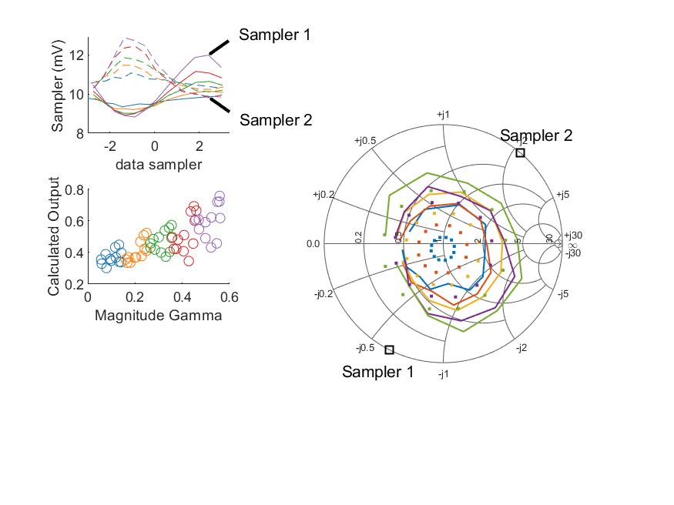
Coupled Line Performance At 11.40 GHz, 18.000000 dBm Output Power 1.00 V mean sampler bias
Sampler Av
Sampler 1: 186.820
Sampler 2: 262.115
Sampler Offset (rather than -1)
-4.4644800144133949
Sampler 1 Range
0.00317
Sampler 2 Range
0.00306
DUT output dBm Mean
17.98057
DUT input dBm Mean
18.48904
RMS Error
0.18611

Slide 20
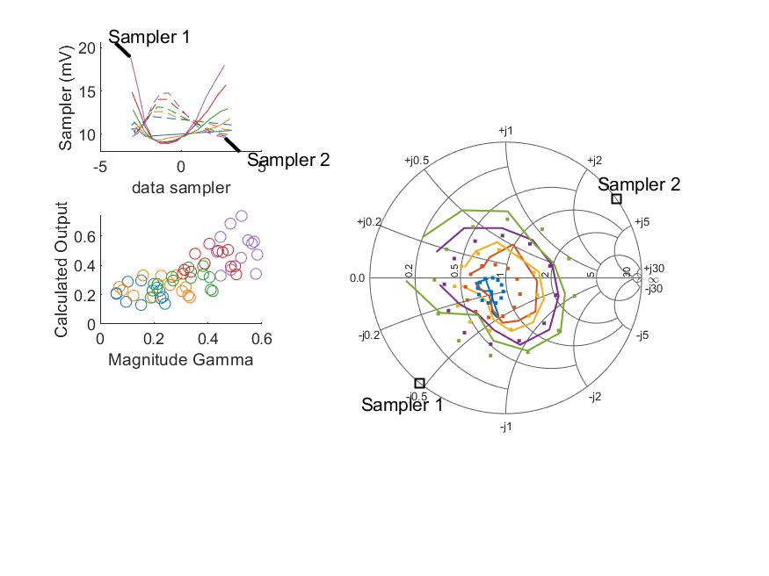
Coupled Line Performance At 10.60 GHz, 20.000000 dBm Output Power 1.00 V mean sampler bias
Sampler Av
Sampler 1: 80.745
Sampler 2: 114.636
Sampler Offset (rather than -1)
-2.088820866497791
Sampler 1 Range
0.00996
Sampler 2 Range
0.00515
DUT output dBm Mean
19.95554
DUT input dBm Mean
20.52320
RMS Error
0.10591

Slide 21
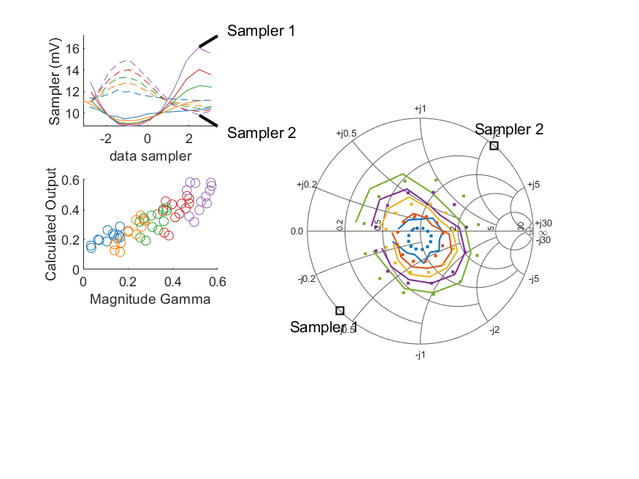
Coupled Line Performance At 10.70 GHz, 20.000000 dBm Output Power 1.00 V mean sampler bias
Sampler Av
Sampler 1: 80.745
Sampler 2: 114.636
Sampler Offset (rather than -1)
-2.088820866497791
Sampler 1 Range
0.00728
Sampler 2 Range
0.00510
DUT output dBm Mean
19.97484
DUT input dBm Mean
20.41074
RMS Error
0.07873

Slide 22
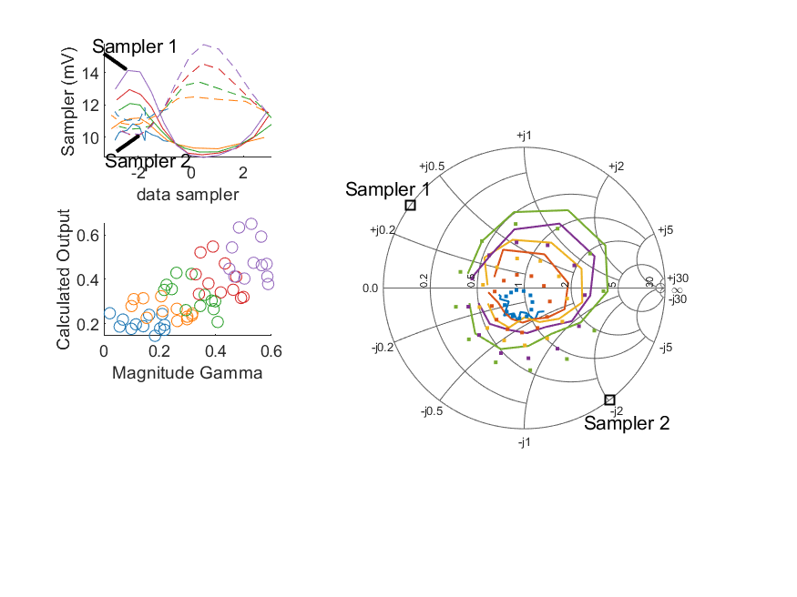
Coupled Line Performance At 10.80 GHz, 20.000000 dBm Output Power 1.00 V mean sampler bias
Sampler Av
Sampler 1: 80.745
Sampler 2: 114.636
Sampler Offset (rather than -1)
-2.088820866497791
Sampler 1 Range
0.00538
Sampler 2 Range
0.00557
DUT output dBm Mean
19.95833
DUT input dBm Mean
20.41704
RMS Error
0.11415

Slide 23
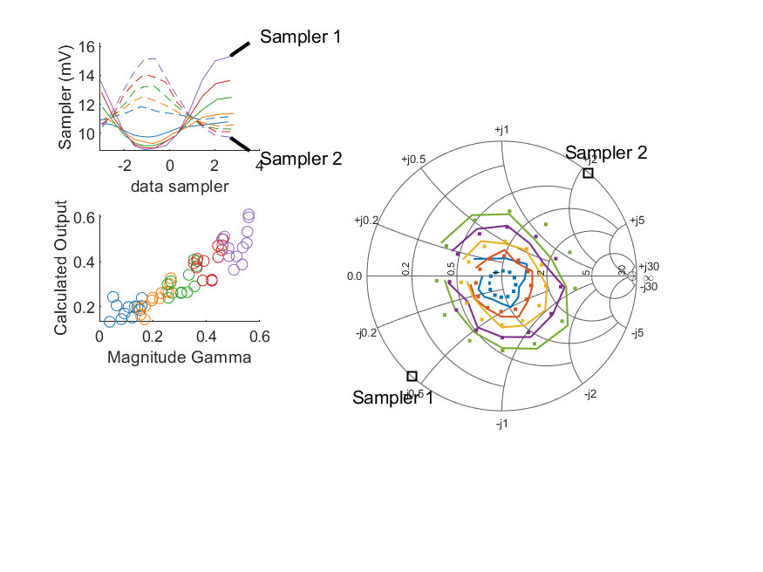
Coupled Line Performance At 10.90 GHz, 20.000000 dBm Output Power 1.00 V mean sampler bias
Sampler Av
Sampler 1: 80.745
Sampler 2: 114.636
Sampler Offset (rather than -1)
-2.088820866497791
Sampler 1 Range
0.00643
Sampler 2 Range
0.00542
DUT output dBm Mean
19.95208
DUT input dBm Mean
20.47927
RMS Error
0.06337

Slide 24
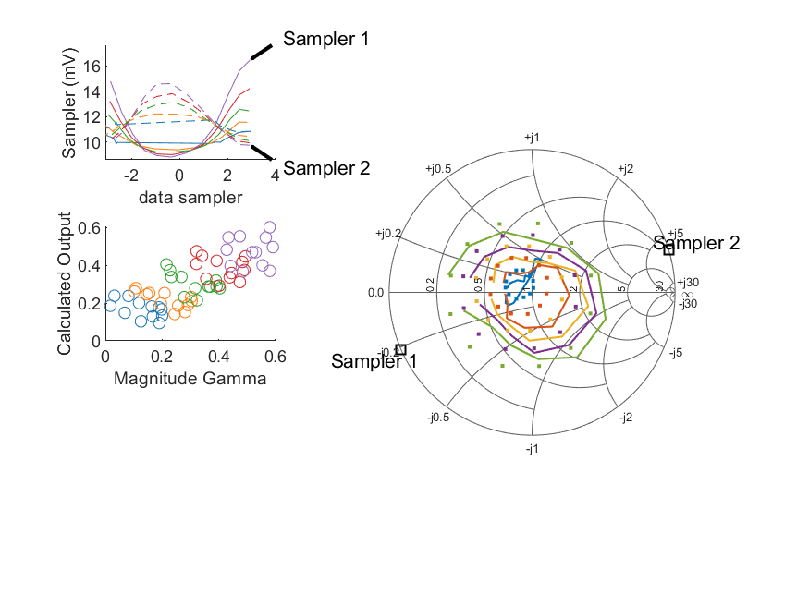
Coupled Line Performance At 11.00 GHz, 20.000000 dBm Output Power 1.00 V mean sampler bias
Sampler Av
Sampler 1: 80.745
Sampler 2: 114.636
Sampler Offset (rather than -1)
-2.088820866497791
Sampler 1 Range
0.00766
Sampler 2 Range
0.00486
DUT output dBm Mean
19.97735
DUT input dBm Mean
20.42446
RMS Error
0.10258

Slide 25
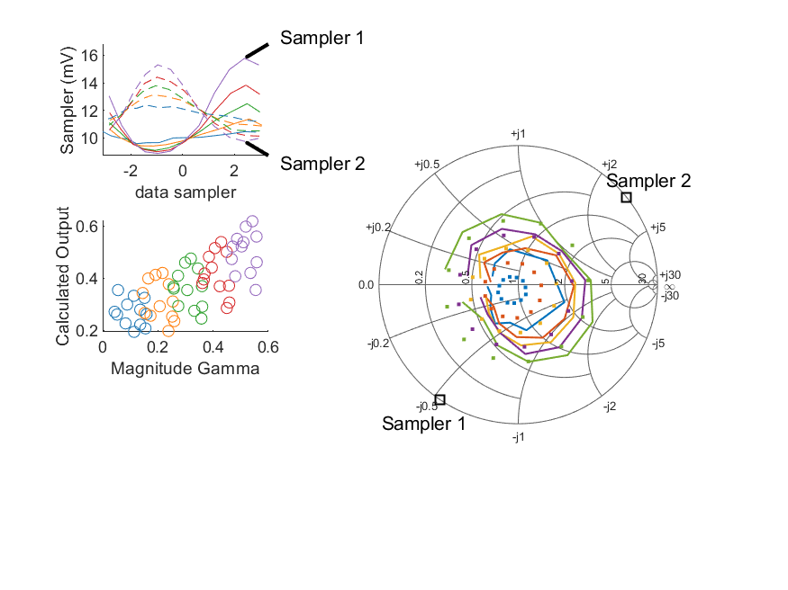
Coupled Line Performance At 11.10 GHz, 20.000000 dBm Output Power 1.00 V mean sampler bias
Sampler Av
Sampler 1: 80.745
Sampler 2: 114.636
Sampler Offset (rather than -1)
-2.088820866497791
Sampler 1 Range
0.00689
Sampler 2 Range
0.00554
DUT output dBm Mean
19.99462
DUT input dBm Mean
20.48489
RMS Error
0.12429

Slide 26
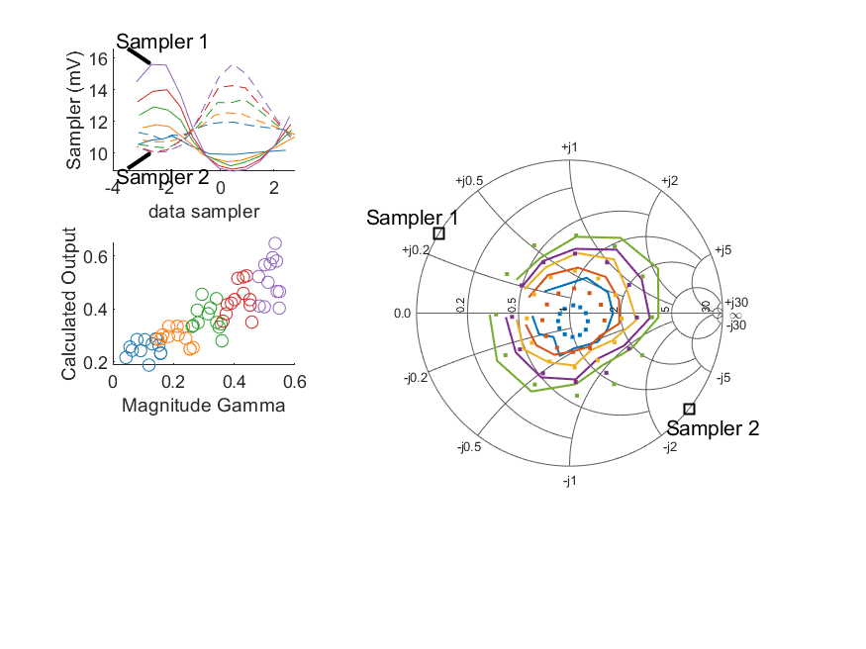
Coupled Line Performance At 11.20 GHz, 20.000000 dBm Output Power 1.00 V mean sampler bias
Sampler Av
Sampler 1: 80.745
Sampler 2: 114.636
Sampler Offset (rather than -1)
-2.088820866497791
Sampler 1 Range
0.00675
Sampler 2 Range
0.00560
DUT output dBm Mean
19.96828
DUT input dBm Mean
20.49061
RMS Error
0.09956

Slide 27
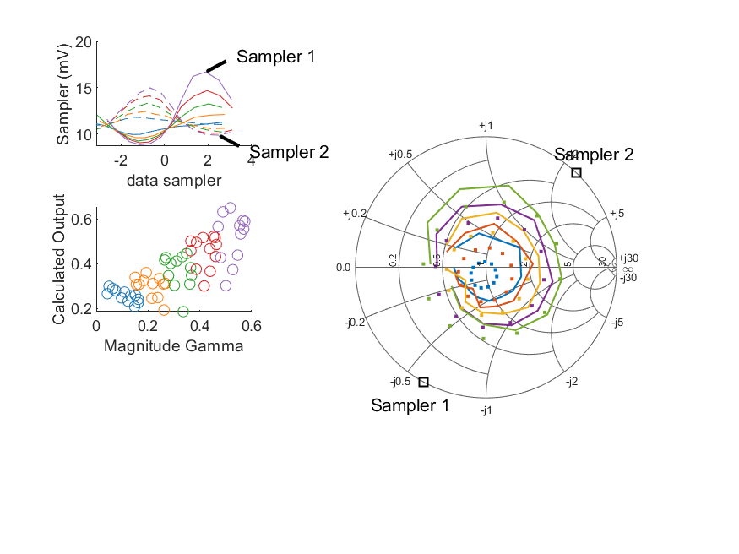
Coupled Line Performance At 11.30 GHz, 20.000000 dBm Output Power 1.00 V mean sampler bias
Sampler Av
Sampler 1: 80.745
Sampler 2: 114.636
Sampler Offset (rather than -1)
-2.088820866497791
Sampler 1 Range
0.00786
Sampler 2 Range
0.00512
DUT output dBm Mean
19.98845
DUT input dBm Mean
20.49725
RMS Error
0.11431

Slide 28
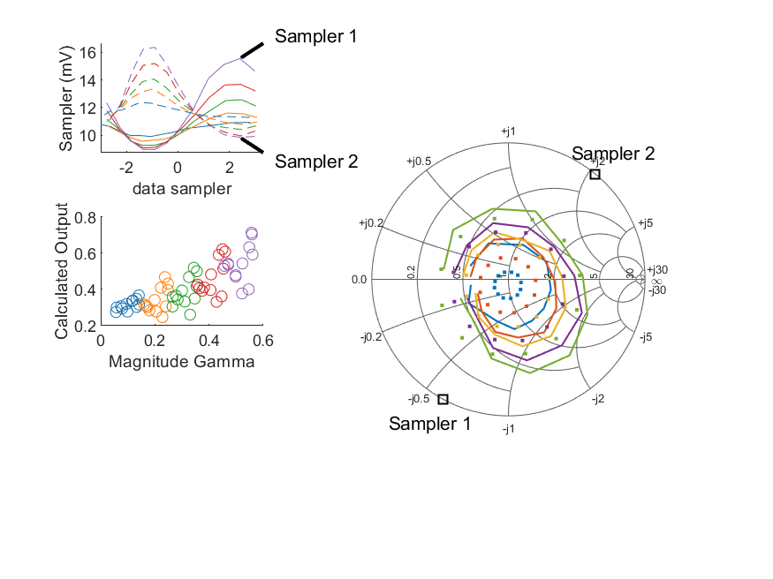
Coupled Line Performance At 11.40 GHz, 20.000000 dBm Output Power 1.00 V mean sampler bias
Sampler Av
Sampler 1: 80.745
Sampler 2: 114.636
Sampler Offset (rather than -1)
-2.088820866497791
Sampler 1 Range
0.00660
Sampler 2 Range
0.00653
DUT output dBm Mean
19.97018
DUT input dBm Mean
20.47952
RMS Error
0.13732

Slide 29
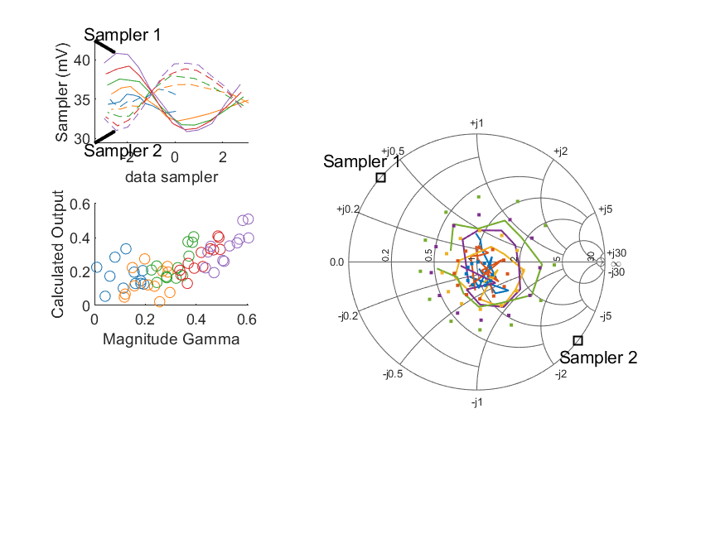
Coupled Line Performance At 10.50 GHz, 12.000000 dBm Output Power 1.25 V mean sampler bias
Sampler Av
Sampler 1: 73.032
Sampler 2: 99.267
Sampler Offset (rather than -1)
-6.0202490571713012
Sampler 1 Range
0.00997
Sampler 2 Range
0.00855
DUT output dBm Mean
11.97690
DUT input dBm Mean
12.35384
RMS Error
0.21050

Slide 30
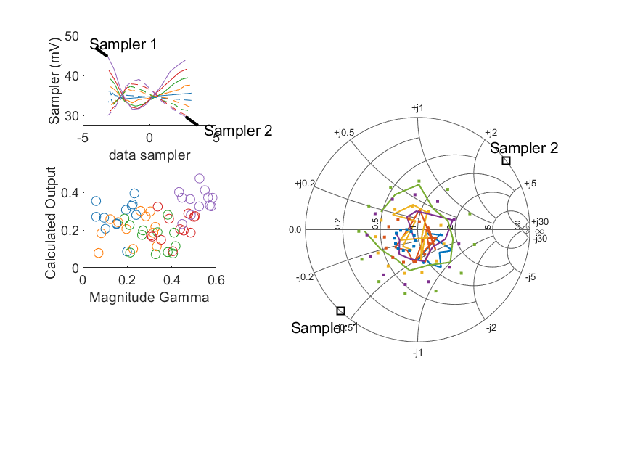
Coupled Line Performance At 10.60 GHz, 12.000000 dBm Output Power 1.25 V mean sampler bias
Sampler Av
Sampler 1: 73.032
Sampler 2: 99.267
Sampler Offset (rather than -1)
-6.0202490571713012
Sampler 1 Range
0.01319
Sampler 2 Range
0.00930
DUT output dBm Mean
11.95880
DUT input dBm Mean
12.51334
RMS Error
0.27439

Slide 31
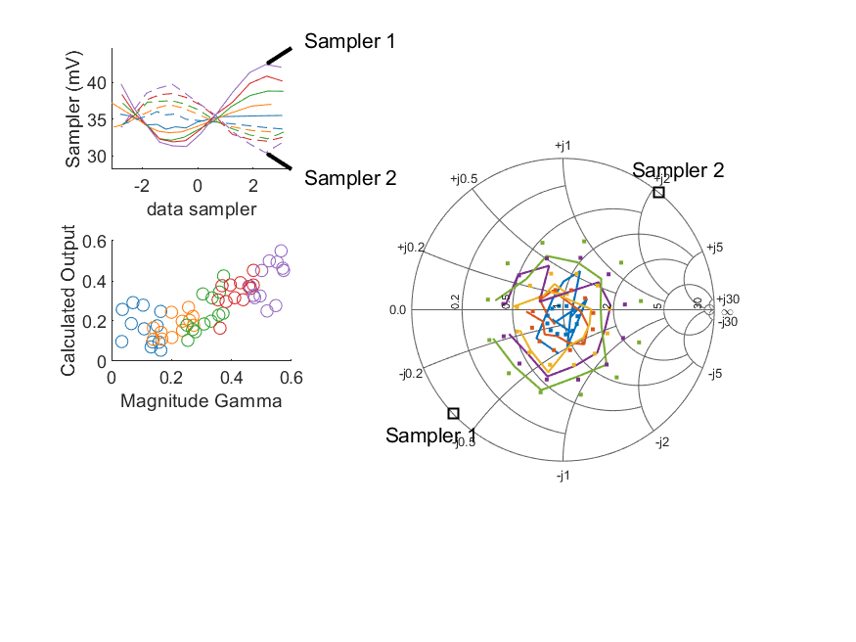
Coupled Line Performance At 10.70 GHz, 12.000000 dBm Output Power 1.25 V mean sampler bias
Sampler Av
Sampler 1: 73.032
Sampler 2: 99.267
Sampler Offset (rather than -1)
-6.0202490571713012
Sampler 1 Range
0.01112
Sampler 2 Range
0.00927
DUT output dBm Mean
11.99715
DUT input dBm Mean
12.41888
RMS Error
0.14886

Slide 32
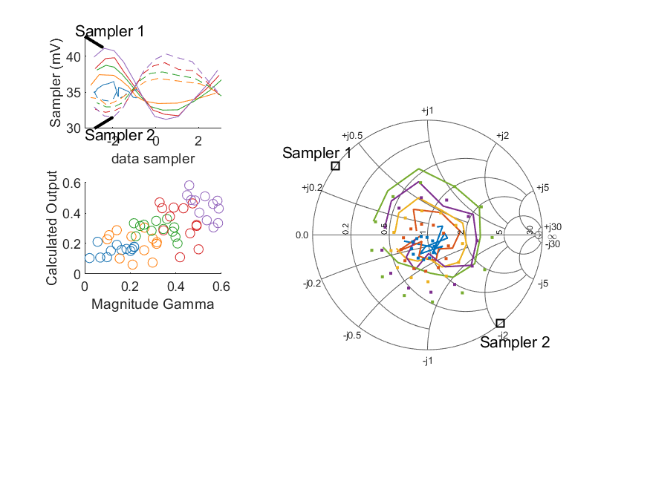
Coupled Line Performance At 10.80 GHz, 12.000000 dBm Output Power 1.25 V mean sampler bias
Sampler Av
Sampler 1: 73.032
Sampler 2: 99.267
Sampler Offset (rather than -1)
-6.0202490571713012
Sampler 1 Range
0.00989
Sampler 2 Range
0.00871
DUT output dBm Mean
11.97586
DUT input dBm Mean
12.42022
RMS Error
0.14782

Slide 33
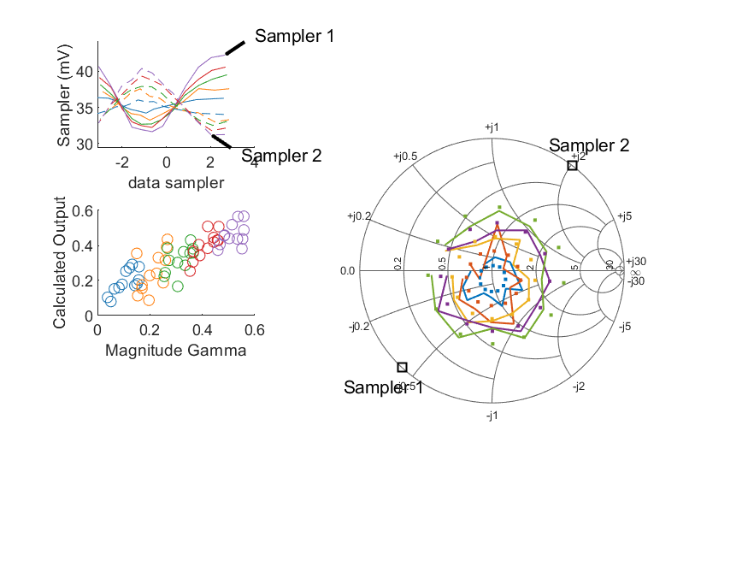
Coupled Line Performance At 10.90 GHz, 12.000000 dBm Output Power 1.25 V mean sampler bias
Sampler Av
Sampler 1: 73.032
Sampler 2: 99.267
Sampler Offset (rather than -1)
-6.0202490571713012
Sampler 1 Range
0.01060
Sampler 2 Range
0.00918
DUT output dBm Mean
11.96901
DUT input dBm Mean
12.48683
RMS Error
0.08309

Slide 34
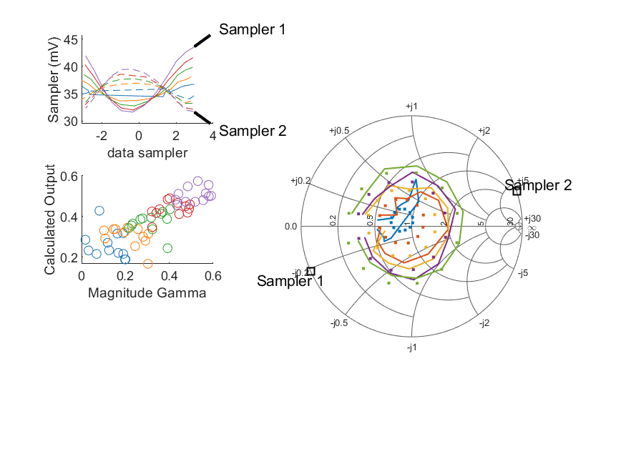
Coupled Line Performance At 11.00 GHz, 12.000000 dBm Output Power 1.25 V mean sampler bias
Sampler Av
Sampler 1: 73.032
Sampler 2: 99.267
Sampler Offset (rather than -1)
-6.0202490571713012
Sampler 1 Range
0.01191
Sampler 2 Range
0.00775
DUT output dBm Mean
11.99300
DUT input dBm Mean
12.42804
RMS Error
0.11175

Slide 35
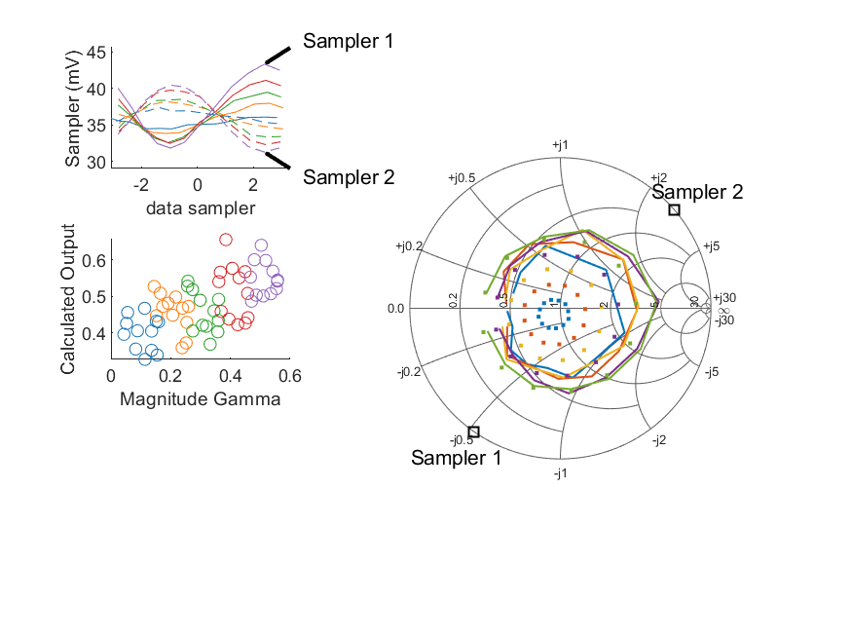
Coupled Line Performance At 11.10 GHz, 12.000000 dBm Output Power 1.25 V mean sampler bias
Sampler Av
Sampler 1: 73.032
Sampler 2: 99.267
Sampler Offset (rather than -1)
-6.0202490571713012
Sampler 1 Range
0.01148
Sampler 2 Range
0.00916
DUT output dBm Mean
12.01753
DUT input dBm Mean
12.50236
RMS Error
0.20412

Slide 36
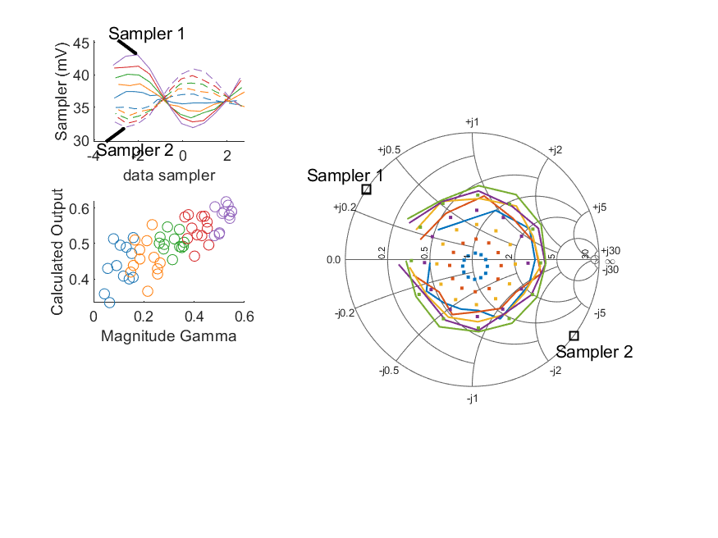
Coupled Line Performance At 11.20 GHz, 12.000000 dBm Output Power 1.25 V mean sampler bias
Sampler Av
Sampler 1: 73.032
Sampler 2: 99.267
Sampler Offset (rather than -1)
-6.0202490571713012
Sampler 1 Range
0.01119
Sampler 2 Range
0.00896
DUT output dBm Mean
11.99410
DUT input dBm Mean
12.50507
RMS Error
0.21784

Slide 37
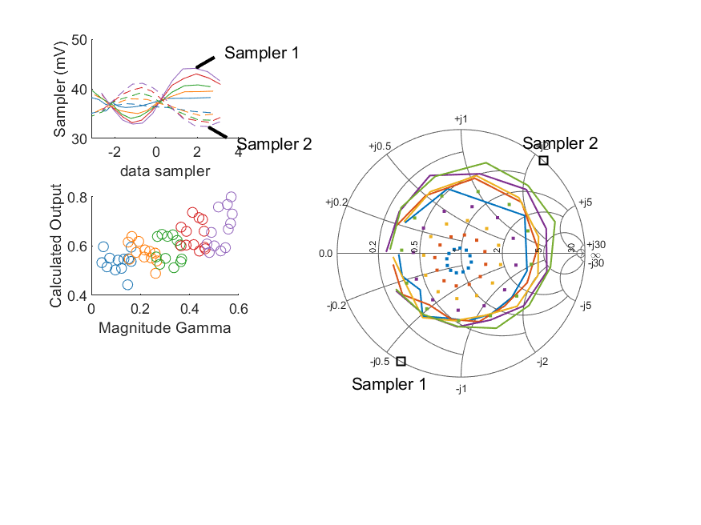
Coupled Line Performance At 11.30 GHz, 12.000000 dBm Output Power 1.25 V mean sampler bias
Sampler Av
Sampler 1: 73.032
Sampler 2: 99.267
Sampler Offset (rather than -1)
-6.0202490571713012
Sampler 1 Range
0.01123
Sampler 2 Range
0.00872
DUT output dBm Mean
12.00444
DUT input dBm Mean
12.50373
RMS Error
0.30766

Slide 38
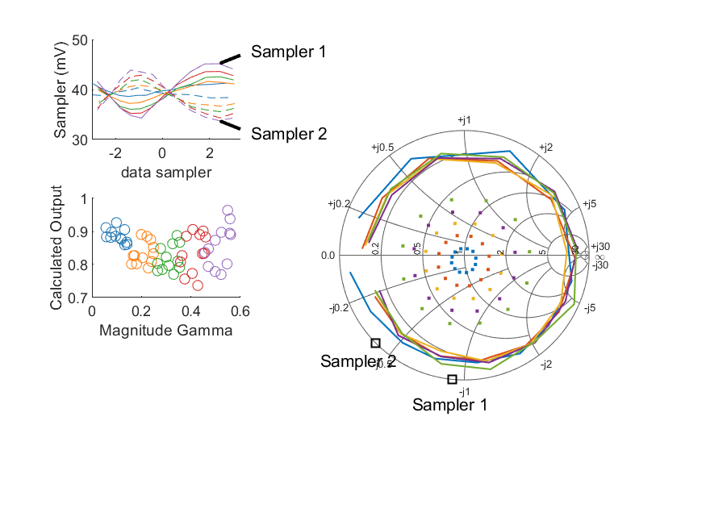
Coupled Line Performance At 11.40 GHz, 12.000000 dBm Output Power 1.25 V mean sampler bias
Sampler Av
Sampler 1: 73.032
Sampler 2: 99.267
Sampler Offset (rather than -1)
-6.0202490571713012
Sampler 1 Range
0.01088
Sampler 2 Range
0.01013
DUT output dBm Mean
11.99206
DUT input dBm Mean
12.49232
RMS Error
0.55937

Slide 39
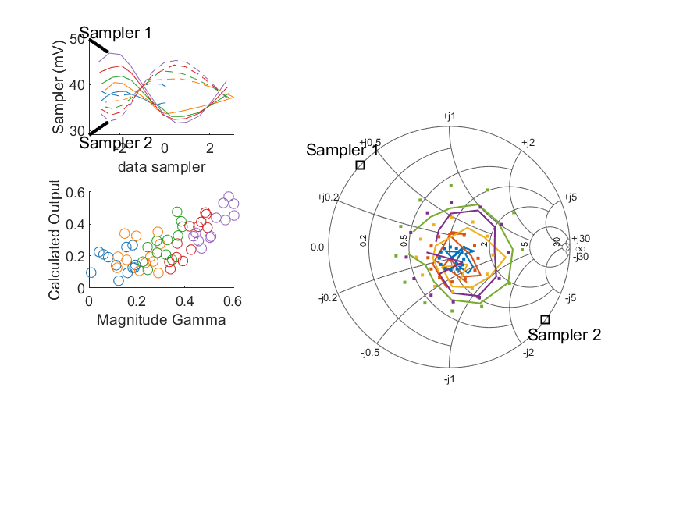
Coupled Line Performance At 10.50 GHz, 14.000000 dBm Output Power 1.25 V mean sampler bias
Sampler Av
Sampler 1: 63.330
Sampler 2: 83.676
Sampler Offset (rather than -1)
-5.5787199607588462
Sampler 1 Range
0.01516
Sampler 2 Range
0.01319
DUT output dBm Mean
13.93180
DUT input dBm Mean
14.31061
RMS Error
0.17918

Slide 40
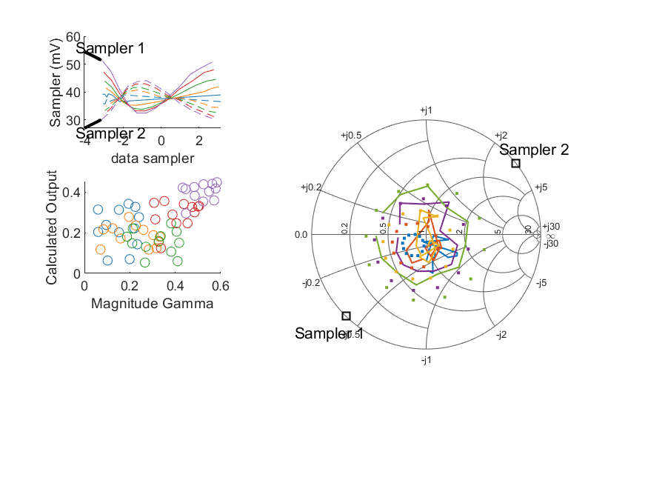
Coupled Line Performance At 10.60 GHz, 14.000000 dBm Output Power 1.25 V mean sampler bias
Sampler Av
Sampler 1: 63.330
Sampler 2: 83.676
Sampler Offset (rather than -1)
-5.5787199607588462
Sampler 1 Range
0.01887
Sampler 2 Range
0.01393
DUT output dBm Mean
13.91625
DUT input dBm Mean
14.47170
RMS Error
0.23649

Slide 41
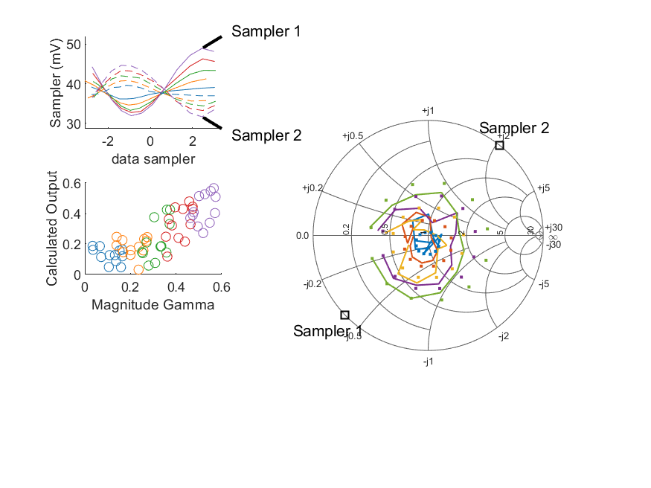
Coupled Line Performance At 10.70 GHz, 14.000000 dBm Output Power 1.25 V mean sampler bias
Sampler Av
Sampler 1: 63.330
Sampler 2: 83.676
Sampler Offset (rather than -1)
-5.5787199607588462
Sampler 1 Range
0.01704
Sampler 2 Range
0.01302
DUT output dBm Mean
13.94898
DUT input dBm Mean
14.37143
RMS Error
0.14529

Slide 42
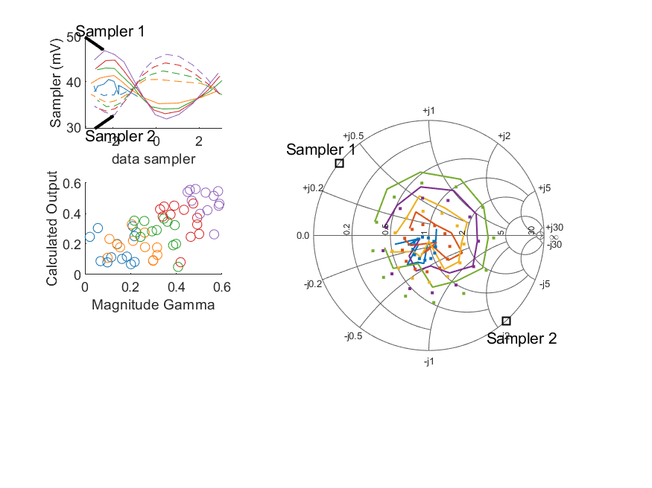
Coupled Line Performance At 10.80 GHz, 14.000000 dBm Output Power 1.25 V mean sampler bias
Sampler Av
Sampler 1: 63.330
Sampler 2: 83.676
Sampler Offset (rather than -1)
-5.5787199607588462
Sampler 1 Range
0.01507
Sampler 2 Range
0.01338
DUT output dBm Mean
13.93549
DUT input dBm Mean
14.38026
RMS Error
0.13667

Slide 43
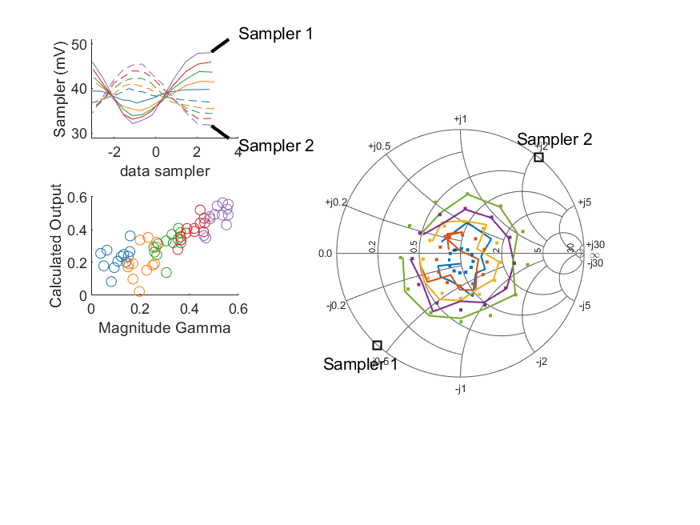
Coupled Line Performance At 10.90 GHz, 14.000000 dBm Output Power 1.25 V mean sampler bias
Sampler Av
Sampler 1: 63.330
Sampler 2: 83.676
Sampler Offset (rather than -1)
-5.5787199607588462
Sampler 1 Range
0.01588
Sampler 2 Range
0.01364
DUT output dBm Mean
13.92341
DUT input dBm Mean
14.44060
RMS Error
0.09116

Slide 44
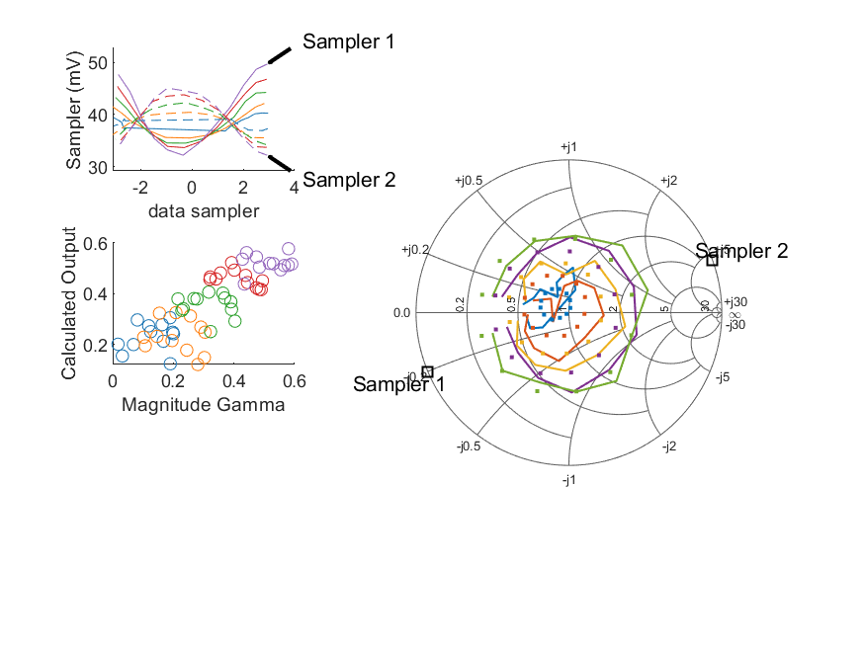
Coupled Line Performance At 11.00 GHz, 14.000000 dBm Output Power 1.25 V mean sampler bias
Sampler Av
Sampler 1: 63.330
Sampler 2: 83.676
Sampler Offset (rather than -1)
-5.5787199607588462
Sampler 1 Range
0.01754
Sampler 2 Range
0.01292
DUT output dBm Mean
13.95098
DUT input dBm Mean
14.38547
RMS Error
0.10436

Slide 45
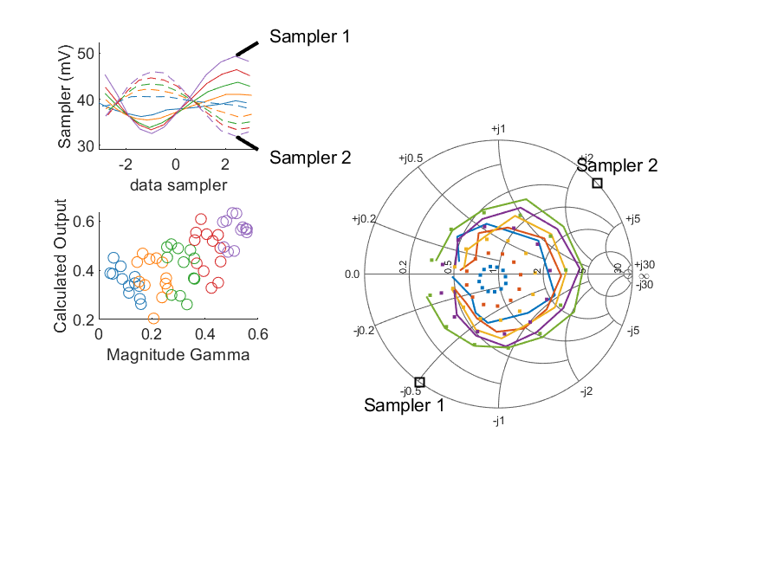
Coupled Line Performance At 11.10 GHz, 14.000000 dBm Output Power 1.25 V mean sampler bias
Sampler Av
Sampler 1: 63.330
Sampler 2: 83.676
Sampler Offset (rather than -1)
-5.5787199607588462
Sampler 1 Range
0.01680
Sampler 2 Range
0.01397
DUT output dBm Mean
13.97130
DUT input dBm Mean
14.45605
RMS Error
0.16908

Slide 46
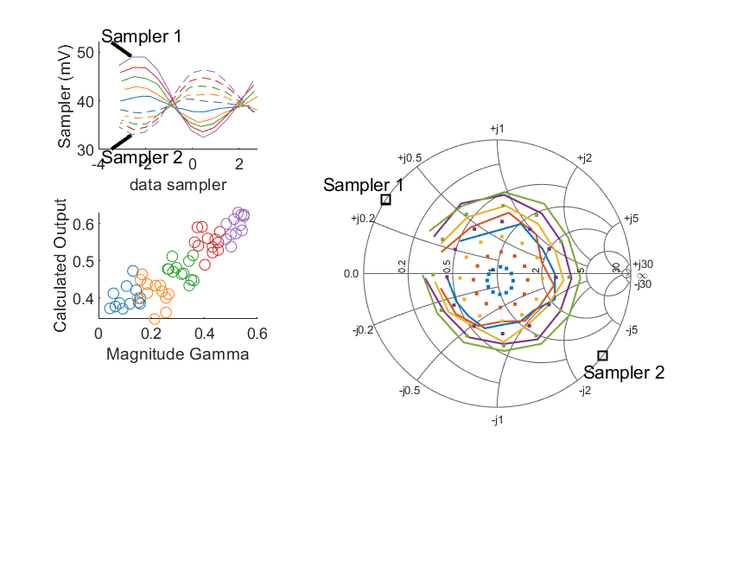
Coupled Line Performance At 11.20 GHz, 14.000000 dBm Output Power 1.25 V mean sampler bias
Sampler Av
Sampler 1: 63.330
Sampler 2: 83.676
Sampler Offset (rather than -1)
-5.5787199607588462
Sampler 1 Range
0.01649
Sampler 2 Range
0.01326
DUT output dBm Mean
13.94430
DUT input dBm Mean
14.45486
RMS Error
0.19303

Slide 47
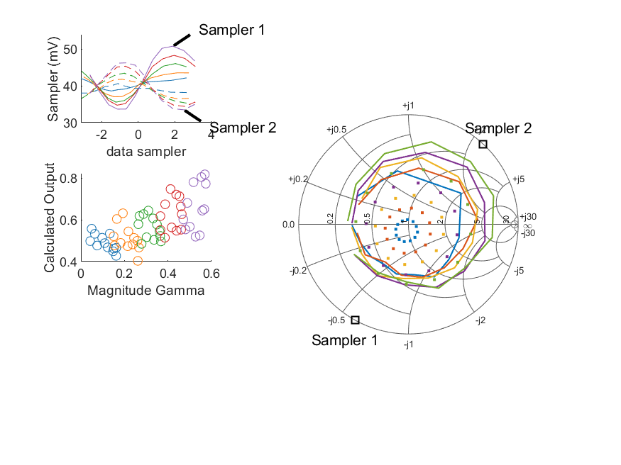
Coupled Line Performance At 11.30 GHz, 14.000000 dBm Output Power 1.25 V mean sampler bias
Sampler Av
Sampler 1: 63.330
Sampler 2: 83.676
Sampler Offset (rather than -1)
-5.5787199607588462
Sampler 1 Range
0.01708
Sampler 2 Range
0.01275
DUT output dBm Mean
13.96108
DUT input dBm Mean
14.45967
RMS Error
0.27657

Slide 48
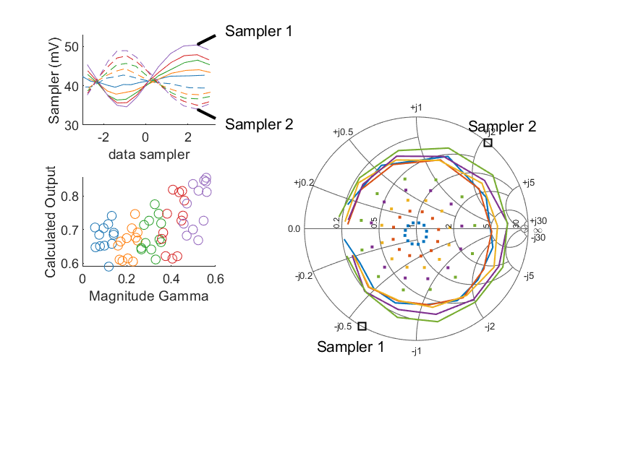
Coupled Line Performance At 11.40 GHz, 14.000000 dBm Output Power 1.25 V mean sampler bias
Sampler Av
Sampler 1: 63.330
Sampler 2: 83.676
Sampler Offset (rather than -1)
-5.5787199607588462
Sampler 1 Range
0.01575
Sampler 2 Range
0.01485
DUT output dBm Mean
13.94967
DUT input dBm Mean
14.44990
RMS Error
0.41064

Slide 49
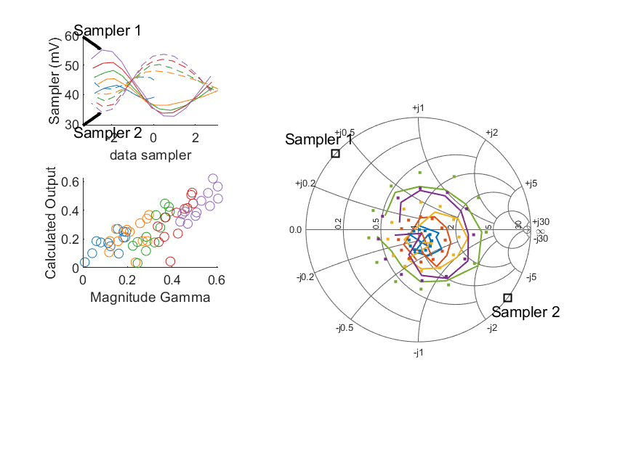
Coupled Line Performance At 10.50 GHz, 16.000000 dBm Output Power 1.25 V mean sampler bias
Sampler Av
Sampler 1: 46.630
Sampler 2: 60.057
Sampler Offset (rather than -1)
-4.5202169113830299
Sampler 1 Range
0.02246
Sampler 2 Range
0.01964
DUT output dBm Mean
15.89143
DUT input dBm Mean
16.27347
RMS Error
0.14944

Slide 50
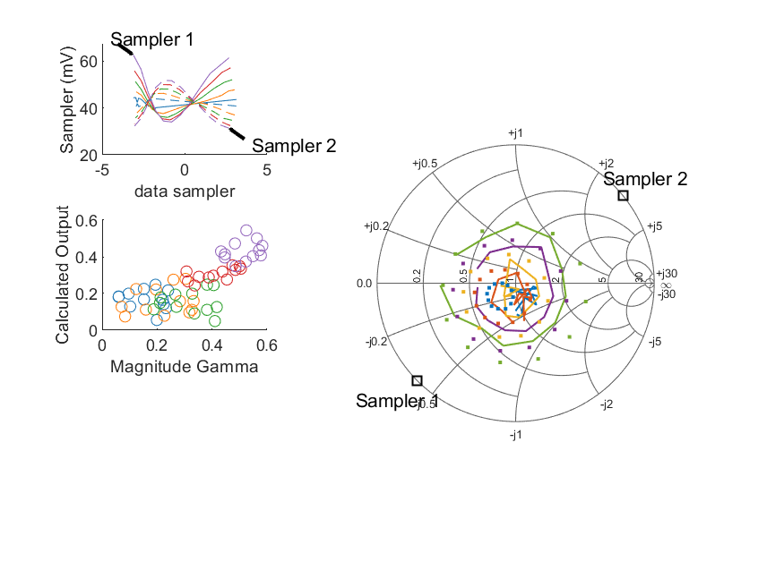
Coupled Line Performance At 10.60 GHz, 16.000000 dBm Output Power 1.25 V mean sampler bias
Sampler Av
Sampler 1: 46.630
Sampler 2: 60.057
Sampler Offset (rather than -1)
-4.5202169113830299
Sampler 1 Range
0.02863
Sampler 2 Range
0.02033
DUT output dBm Mean
15.88481
DUT input dBm Mean
16.44211
RMS Error
0.20576

Slide 51
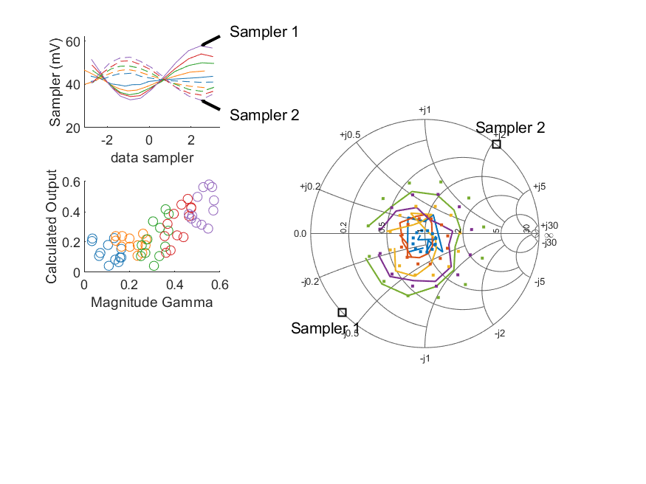
Coupled Line Performance At 10.70 GHz, 16.000000 dBm Output Power 1.25 V mean sampler bias
Sampler Av
Sampler 1: 46.630
Sampler 2: 60.057
Sampler Offset (rather than -1)
-4.5202169113830299
Sampler 1 Range
0.02490
Sampler 2 Range
0.01978
DUT output dBm Mean
15.91656
DUT input dBm Mean
16.34040
RMS Error
0.15845

Slide 52

Coupled Line Performance At 10.80 GHz, 16.000000 dBm Output Power 1.25 V mean sampler bias
Sampler Av
Sampler 1: 46.630
Sampler 2: 60.057
Sampler Offset (rather than -1)
-4.5202169113830299
Sampler 1 Range
0.02176
Sampler 2 Range
0.01962
DUT output dBm Mean
15.89489
DUT input dBm Mean
16.34168
RMS Error
0.12944

Slide 53

Coupled Line Performance At 10.90 GHz, 16.000000 dBm Output Power 1.25 V mean sampler bias
Sampler Av
Sampler 1: 46.630
Sampler 2: 60.057
Sampler Offset (rather than -1)
-4.5202169113830299
Sampler 1 Range
0.02367
Sampler 2 Range
0.02011
DUT output dBm Mean
15.88941
DUT input dBm Mean
16.40747
RMS Error
0.05619

Slide 54

Coupled Line Performance At 11.00 GHz, 16.000000 dBm Output Power 1.25 V mean sampler bias
Sampler Av
Sampler 1: 46.630
Sampler 2: 60.057
Sampler Offset (rather than -1)
-4.5202169113830299
Sampler 1 Range
0.02547
Sampler 2 Range
0.01868
DUT output dBm Mean
15.91192
DUT input dBm Mean
16.34808
RMS Error
0.08777

Slide 55

Coupled Line Performance At 11.10 GHz, 16.000000 dBm Output Power 1.25 V mean sampler bias
Sampler Av
Sampler 1: 46.630
Sampler 2: 60.057
Sampler Offset (rather than -1)
-4.5202169113830299
Sampler 1 Range
0.02432
Sampler 2 Range
0.02143
DUT output dBm Mean
15.94221
DUT input dBm Mean
16.42825
RMS Error
0.15812

Slide 56

Coupled Line Performance At 11.20 GHz, 16.000000 dBm Output Power 1.25 V mean sampler bias
Sampler Av
Sampler 1: 46.630
Sampler 2: 60.057
Sampler Offset (rather than -1)
-4.5202169113830299
Sampler 1 Range
0.02448
Sampler 2 Range
0.01989
DUT output dBm Mean
15.90423
DUT input dBm Mean
16.41613
RMS Error
0.16028

Slide 57

Coupled Line Performance At 11.30 GHz, 16.000000 dBm Output Power 1.25 V mean sampler bias
Sampler Av
Sampler 1: 46.630
Sampler 2: 60.057
Sampler Offset (rather than -1)
-4.5202169113830299
Sampler 1 Range
0.02582
Sampler 2 Range
0.01947
DUT output dBm Mean
15.93590
DUT input dBm Mean
16.43511
RMS Error
0.26327

Slide 58

Coupled Line Performance At 11.40 GHz, 16.000000 dBm Output Power 1.25 V mean sampler bias
Sampler Av
Sampler 1: 46.630
Sampler 2: 60.057
Sampler Offset (rather than -1)
-4.5202169113830299
Sampler 1 Range
0.02300
Sampler 2 Range
0.02260
DUT output dBm Mean
15.90804
DUT input dBm Mean
16.40901
RMS Error
0.29391

Slide 59

Coupled Line Performance At 10.50 GHz, 8.000000 dBm Output Power 1.50 V mean sampler bias
Sampler Av
Sampler 1: 122.714
Sampler 2: 147.987
Sampler Offset (rather than -1)
-35.812914468322518
Sampler 1 Range
0.00740
Sampler 2 Range
0.00726
DUT output dBm Mean
7.98123
DUT input dBm Mean
8.35573
RMS Error
0.46042

Slide 60

Coupled Line Performance At 10.60 GHz, 8.000000 dBm Output Power 1.50 V mean sampler bias
Sampler Av
Sampler 1: 122.714
Sampler 2: 147.987
Sampler Offset (rather than -1)
-35.812914468322518
Sampler 1 Range
0.00946
Sampler 2 Range
0.00749
DUT output dBm Mean
7.96929
DUT input dBm Mean
8.52157
RMS Error
0.44176

Slide 61

Coupled Line Performance At 10.70 GHz, 8.000000 dBm Output Power 1.50 V mean sampler bias
Sampler Av
Sampler 1: 122.714
Sampler 2: 147.987
Sampler Offset (rather than -1)
-35.812914468322518
Sampler 1 Range
0.00821
Sampler 2 Range
0.00731
DUT output dBm Mean
8.00383
DUT input dBm Mean
8.42507
RMS Error
0.33771

Slide 62

Coupled Line Performance At 10.80 GHz, 8.000000 dBm Output Power 1.50 V mean sampler bias
Sampler Av
Sampler 1: 122.714
Sampler 2: 147.987
Sampler Offset (rather than -1)
-35.812914468322518
Sampler 1 Range
0.00734
Sampler 2 Range
0.00718
DUT output dBm Mean
7.98583
DUT input dBm Mean
8.42928
RMS Error
0.22711

Slide 63

Coupled Line Performance At 10.90 GHz, 8.000000 dBm Output Power 1.50 V mean sampler bias
Sampler Av
Sampler 1: 122.714
Sampler 2: 147.987
Sampler Offset (rather than -1)
-35.812914468322518
Sampler 1 Range
0.00781
Sampler 2 Range
0.00729
DUT output dBm Mean
7.98851
DUT input dBm Mean
8.50248
RMS Error
0.08831

Slide 64

Coupled Line Performance At 11.00 GHz, 8.000000 dBm Output Power 1.50 V mean sampler bias
Sampler Av
Sampler 1: 122.714
Sampler 2: 147.987
Sampler Offset (rather than -1)
-35.812914468322518
Sampler 1 Range
0.00851
Sampler 2 Range
0.00666
DUT output dBm Mean
8.00101
DUT input dBm Mean
8.43453
RMS Error
0.15872

Slide 65

Coupled Line Performance At 11.10 GHz, 8.000000 dBm Output Power 1.50 V mean sampler bias
Sampler Av
Sampler 1: 122.714
Sampler 2: 147.987
Sampler Offset (rather than -1)
-35.812914468322518
Sampler 1 Range
0.00819
Sampler 2 Range
0.00761
DUT output dBm Mean
8.02406
DUT input dBm Mean
8.50690
RMS Error
0.28422

Slide 66

Coupled Line Performance At 11.20 GHz, 8.000000 dBm Output Power 1.50 V mean sampler bias
Sampler Av
Sampler 1: 122.714
Sampler 2: 147.987
Sampler Offset (rather than -1)
-35.812914468322518
Sampler 1 Range
0.00828
Sampler 2 Range
0.00718
DUT output dBm Mean
8.00285
DUT input dBm Mean
8.51427
RMS Error
0.35850

Slide 67

Coupled Line Performance At 11.30 GHz, 8.000000 dBm Output Power 1.50 V mean sampler bias
Sampler Av
Sampler 1: 122.714
Sampler 2: 147.987
Sampler Offset (rather than -1)
-35.812914468322518
Sampler 1 Range
0.00843
Sampler 2 Range
0.00716
DUT output dBm Mean
8.02025
DUT input dBm Mean
8.51770
RMS Error
0.47290

Slide 68

Coupled Line Performance At 11.40 GHz, 8.000000 dBm Output Power 1.50 V mean sampler bias
Sampler Av
Sampler 1: 122.714
Sampler 2: 147.987
Sampler Offset (rather than -1)
-35.812914468322518
Sampler 1 Range
0.00783
Sampler 2 Range
0.00797
DUT output dBm Mean
7.99605
DUT input dBm Mean
8.49604
RMS Error
0.76006

Slide 69

Coupled Line Performance At 10.50 GHz, 10.000000 dBm Output Power 1.50 V mean sampler bias
Sampler Av
Sampler 1: 95.816
Sampler 2: 115.848
Sampler Offset (rather than -1)
-28.508052772407815
Sampler 1 Range
0.01116
Sampler 2 Range
0.01093
DUT output dBm Mean
9.97418
DUT input dBm Mean
10.35095
RMS Error
0.37087

Slide 70

Coupled Line Performance At 10.60 GHz, 10.000000 dBm Output Power 1.50 V mean sampler bias
Sampler Av
Sampler 1: 95.816
Sampler 2: 115.848
Sampler Offset (rather than -1)
-28.508052772407815
Sampler 1 Range
0.01410
Sampler 2 Range
0.01141
DUT output dBm Mean
9.96974
DUT input dBm Mean
10.52382
RMS Error
0.37949

Slide 71

Coupled Line Performance At 10.70 GHz, 10.000000 dBm Output Power 1.50 V mean sampler bias
Sampler Av
Sampler 1: 95.816
Sampler 2: 115.848
Sampler Offset (rather than -1)
-28.508052772407815
Sampler 1 Range
0.01243
Sampler 2 Range
0.01089
DUT output dBm Mean
10.00731
DUT input dBm Mean
10.42920
RMS Error
0.26654

Slide 72

Coupled Line Performance At 10.80 GHz, 10.000000 dBm Output Power 1.50 V mean sampler bias
Sampler Av
Sampler 1: 95.816
Sampler 2: 115.848
Sampler Offset (rather than -1)
-28.508052772407815
Sampler 1 Range
0.01079
Sampler 2 Range
0.01080
DUT output dBm Mean
9.98344
DUT input dBm Mean
10.42717
RMS Error
0.23317

Slide 73

Coupled Line Performance At 10.90 GHz, 10.000000 dBm Output Power 1.50 V mean sampler bias
Sampler Av
Sampler 1: 95.816
Sampler 2: 115.848
Sampler Offset (rather than -1)
-28.508052772407815
Sampler 1 Range
0.01193
Sampler 2 Range
0.01073
DUT output dBm Mean
9.98551
DUT input dBm Mean
10.50024
RMS Error
0.06392

Slide 74

Coupled Line Performance At 11.00 GHz, 10.000000 dBm Output Power 1.50 V mean sampler bias
Sampler Av
Sampler 1: 95.816
Sampler 2: 115.848
Sampler Offset (rather than -1)
-28.508052772407815
Sampler 1 Range
0.01279
Sampler 2 Range
0.01051
DUT output dBm Mean
10.00471
DUT input dBm Mean
10.43817
RMS Error
0.13118

Slide 75

Coupled Line Performance At 11.10 GHz, 10.000000 dBm Output Power 1.50 V mean sampler bias
Sampler Av
Sampler 1: 95.816
Sampler 2: 115.848
Sampler Offset (rather than -1)
-28.508052772407815
Sampler 1 Range
0.01214
Sampler 2 Range
0.01156
DUT output dBm Mean
10.02668
DUT input dBm Mean
10.51026
RMS Error
0.25596

Slide 76

Coupled Line Performance At 11.20 GHz, 10.000000 dBm Output Power 1.50 V mean sampler bias
Sampler Av
Sampler 1: 95.816
Sampler 2: 115.848
Sampler Offset (rather than -1)
-28.508052772407815
Sampler 1 Range
0.01260
Sampler 2 Range
0.01051
DUT output dBm Mean
9.99443
DUT input dBm Mean
10.50443
RMS Error
0.30379

Slide 77

Coupled Line Performance At 11.30 GHz, 10.000000 dBm Output Power 1.50 V mean sampler bias
Sampler Av
Sampler 1: 95.816
Sampler 2: 115.848
Sampler Offset (rather than -1)
-28.508052772407815
Sampler 1 Range
0.01297
Sampler 2 Range
0.01076
DUT output dBm Mean
10.01223
DUT input dBm Mean
10.50920
RMS Error
0.38404

Slide 78

Coupled Line Performance At 11.40 GHz, 10.000000 dBm Output Power 1.50 V mean sampler bias
Sampler Av
Sampler 1: 95.816
Sampler 2: 115.848
Sampler Offset (rather than -1)
-28.508052772407815
Sampler 1 Range
0.01160
Sampler 2 Range
0.01249
DUT output dBm Mean
10.00137
DUT input dBm Mean
10.50063
RMS Error
0.54011

Slide 79

Coupled Line Performance At 10.50 GHz, 12.000000 dBm Output Power 1.50 V mean sampler bias
Sampler Av
Sampler 1: 68.733
Sampler 2: 81.580
Sampler Offset (rather than -1)
-20.764033488139241
Sampler 1 Range
0.01689
Sampler 2 Range
0.01569
DUT output dBm Mean
11.96207
DUT input dBm Mean
12.34063
RMS Error
0.26172

Slide 80

Coupled Line Performance At 10.60 GHz, 12.000000 dBm Output Power 1.50 V mean sampler bias
Sampler Av
Sampler 1: 68.733
Sampler 2: 81.580
Sampler Offset (rather than -1)
-20.764033488139241
Sampler 1 Range
0.02087
Sampler 2 Range
0.01652
DUT output dBm Mean
11.94602
DUT input dBm Mean
12.50079
RMS Error
0.31863

Slide 81

Coupled Line Performance At 10.70 GHz, 12.000000 dBm Output Power 1.50 V mean sampler bias
Sampler Av
Sampler 1: 68.733
Sampler 2: 81.580
Sampler Offset (rather than -1)
-20.764033488139241
Sampler 1 Range
0.01845
Sampler 2 Range
0.01567
DUT output dBm Mean
11.98740
DUT input dBm Mean
12.41064
RMS Error
0.20931

Slide 82

Coupled Line Performance At 10.80 GHz, 12.000000 dBm Output Power 1.50 V mean sampler bias
Sampler Av
Sampler 1: 68.733
Sampler 2: 81.580
Sampler Offset (rather than -1)
-20.764033488139241
Sampler 1 Range
0.01601
Sampler 2 Range
0.01565
DUT output dBm Mean
11.96507
DUT input dBm Mean
12.41015
RMS Error
0.19930

Slide 83

Coupled Line Performance At 10.90 GHz, 12.000000 dBm Output Power 1.50 V mean sampler bias
Sampler Av
Sampler 1: 68.733
Sampler 2: 81.580
Sampler Offset (rather than -1)
-20.764033488139241
Sampler 1 Range
0.01751
Sampler 2 Range
0.01597
DUT output dBm Mean
11.95689
DUT input dBm Mean
12.47327
RMS Error
0.06212

Slide 84

Coupled Line Performance At 11.00 GHz, 12.000000 dBm Output Power 1.50 V mean sampler bias
Sampler Av
Sampler 1: 68.733
Sampler 2: 81.580
Sampler Offset (rather than -1)
-20.764033488139241
Sampler 1 Range
0.01875
Sampler 2 Range
0.01523
DUT output dBm Mean
11.98064
DUT input dBm Mean
12.41605
RMS Error
0.11075

Slide 85

Coupled Line Performance At 11.10 GHz, 12.000000 dBm Output Power 1.50 V mean sampler bias
Sampler Av
Sampler 1: 68.733
Sampler 2: 81.580
Sampler Offset (rather than -1)
-20.764033488139241
Sampler 1 Range
0.01790
Sampler 2 Range
0.01710
DUT output dBm Mean
12.00341
DUT input dBm Mean
12.48645
RMS Error
0.20395

Slide 86

Coupled Line Performance At 11.20 GHz, 12.000000 dBm Output Power 1.50 V mean sampler bias
Sampler Av
Sampler 1: 68.733
Sampler 2: 81.580
Sampler Offset (rather than -1)
-20.764033488139241
Sampler 1 Range
0.01823
Sampler 2 Range
0.01580
DUT output dBm Mean
11.97671
DUT input dBm Mean
12.48814
RMS Error
0.23797

Slide 87

Coupled Line Performance At 11.30 GHz, 12.000000 dBm Output Power 1.50 V mean sampler bias
Sampler Av
Sampler 1: 68.733
Sampler 2: 81.580
Sampler Offset (rather than -1)
-20.764033488139241
Sampler 1 Range
0.01914
Sampler 2 Range
0.01566
DUT output dBm Mean
11.99106
DUT input dBm Mean
12.48942
RMS Error
0.31738

Slide 88

Coupled Line Performance At 11.40 GHz, 12.000000 dBm Output Power 1.50 V mean sampler bias
Sampler Av
Sampler 1: 68.733
Sampler 2: 81.580
Sampler Offset (rather than -1)
-20.764033488139241
Sampler 1 Range
0.01693
Sampler 2 Range
0.01789
DUT output dBm Mean
11.97512
DUT input dBm Mean
12.47580
RMS Error
0.40352

Slide 89

Coupled Line Performance At 10.50 GHz, 6.000000 dBm Output Power 1.75 V mean sampler bias
Sampler Av
Sampler 1: 215.612
Sampler 2: 255.008
Sampler Offset (rather than -1)
-124.97885155502534
Sampler 1 Range
0.00457
Sampler 2 Range
0.00458
DUT output dBm Mean
5.94375
DUT input dBm Mean
6.31941
RMS Error
0.57647

Slide 90

Coupled Line Performance At 10.60 GHz, 6.000000 dBm Output Power 1.75 V mean sampler bias
Sampler Av
Sampler 1: 215.612
Sampler 2: 255.008
Sampler Offset (rather than -1)
-124.97885155502534
Sampler 1 Range
0.00577
Sampler 2 Range
0.00489
DUT output dBm Mean
5.93941
DUT input dBm Mean
6.48955
RMS Error
0.54287

Slide 91

Coupled Line Performance At 10.70 GHz, 6.000000 dBm Output Power 1.75 V mean sampler bias
Sampler Av
Sampler 1: 215.612
Sampler 2: 255.008
Sampler Offset (rather than -1)
-124.97885155502534
Sampler 1 Range
0.00510
Sampler 2 Range
0.00447
DUT output dBm Mean
5.97181
DUT input dBm Mean
6.38981
RMS Error
0.39796

Slide 92

Coupled Line Performance At 10.80 GHz, 6.000000 dBm Output Power 1.75 V mean sampler bias
Sampler Av
Sampler 1: 215.612
Sampler 2: 255.008
Sampler Offset (rather than -1)
-124.97885155502534
Sampler 1 Range
0.00446
Sampler 2 Range
0.00462
DUT output dBm Mean
5.93947
DUT input dBm Mean
6.38101
RMS Error
0.27556

Slide 93

Coupled Line Performance At 10.90 GHz, 6.000000 dBm Output Power 1.75 V mean sampler bias
Sampler Av
Sampler 1: 215.612
Sampler 2: 255.008
Sampler Offset (rather than -1)
-124.97885155502534
Sampler 1 Range
0.00481
Sampler 2 Range
0.00458
DUT output dBm Mean
5.93986
DUT input dBm Mean
6.45489
RMS Error
0.06845

Slide 94

Coupled Line Performance At 11.00 GHz, 6.000000 dBm Output Power 1.75 V mean sampler bias
Sampler Av
Sampler 1: 215.612
Sampler 2: 255.008
Sampler Offset (rather than -1)
-124.97885155502534
Sampler 1 Range
0.00532
Sampler 2 Range
0.00435
DUT output dBm Mean
5.96874
DUT input dBm Mean
6.40214
RMS Error
0.22274

Slide 95

Coupled Line Performance At 11.10 GHz, 6.000000 dBm Output Power 1.75 V mean sampler bias
Sampler Av
Sampler 1: 215.612
Sampler 2: 255.008
Sampler Offset (rather than -1)
-124.97885155502534
Sampler 1 Range
0.00508
Sampler 2 Range
0.00511
DUT output dBm Mean
5.98880
DUT input dBm Mean
6.47356
RMS Error
0.38118

Slide 96

Coupled Line Performance At 11.20 GHz, 6.000000 dBm Output Power 1.75 V mean sampler bias
Sampler Av
Sampler 1: 215.612
Sampler 2: 255.008
Sampler Offset (rather than -1)
-124.97885155502534
Sampler 1 Range
0.00524
Sampler 2 Range
0.00438
DUT output dBm Mean
5.95643
DUT input dBm Mean
6.46715
RMS Error
0.49307

Slide 97

Coupled Line Performance At 11.30 GHz, 6.000000 dBm Output Power 1.75 V mean sampler bias
Sampler Av
Sampler 1: 215.612
Sampler 2: 255.008
Sampler Offset (rather than -1)
-124.97885155502534
Sampler 1 Range
0.00526
Sampler 2 Range
0.00446
DUT output dBm Mean
5.97898
DUT input dBm Mean
6.47751
RMS Error
0.64664

Slide 98

Coupled Line Performance At 11.40 GHz, 6.000000 dBm Output Power 1.75 V mean sampler bias
Sampler Av
Sampler 1: 215.612
Sampler 2: 255.008
Sampler Offset (rather than -1)
-124.97885155502534
Sampler 1 Range
0.00475
Sampler 2 Range
0.00517
DUT output dBm Mean
5.99573
DUT input dBm Mean
6.49539
RMS Error
0.88381

Slide 99

Coupled Line Performance At 10.50 GHz, 8.000000 dBm Output Power 1.75 V mean sampler bias
Sampler Av
Sampler 1: 146.145
Sampler 2: 168.355
Sampler Offset (rather than -1)
-84.010319012555428
Sampler 1 Range
0.00706
Sampler 2 Range
0.00700
DUT output dBm Mean
7.99725
DUT input dBm Mean
8.37177
RMS Error
0.44272

Slide 100

Coupled Line Performance At 10.60 GHz, 8.000000 dBm Output Power 1.75 V mean sampler bias
Sampler Av
Sampler 1: 146.145
Sampler 2: 168.355
Sampler Offset (rather than -1)
-84.010319012555428
Sampler 1 Range
0.00919
Sampler 2 Range
0.00726
DUT output dBm Mean
7.98371
DUT input dBm Mean
8.53749
RMS Error
0.44501

Slide 101

Coupled Line Performance At 10.70 GHz, 8.000000 dBm Output Power 1.75 V mean sampler bias
Sampler Av
Sampler 1: 146.145
Sampler 2: 168.355
Sampler Offset (rather than -1)
-84.010319012555428
Sampler 1 Range
0.00815
Sampler 2 Range
0.00702
DUT output dBm Mean
8.01736
DUT input dBm Mean
8.43862
RMS Error
0.30050

Slide 102

Coupled Line Performance At 10.80 GHz, 8.000000 dBm Output Power 1.75 V mean sampler bias
Sampler Av
Sampler 1: 146.145
Sampler 2: 168.355
Sampler Offset (rather than -1)
-84.010319012555428
Sampler 1 Range
0.00690
Sampler 2 Range
0.00717
DUT output dBm Mean
8.00390
DUT input dBm Mean
8.44820
RMS Error
0.23170

Slide 103

Coupled Line Performance At 10.90 GHz, 8.000000 dBm Output Power 1.75 V mean sampler bias
Sampler Av
Sampler 1: 146.145
Sampler 2: 168.355
Sampler Offset (rather than -1)
-84.010319012555428
Sampler 1 Range
0.00751
Sampler 2 Range
0.00718
DUT output dBm Mean
7.99271
DUT input dBm Mean
8.50907
RMS Error
0.05244

Slide 104

Coupled Line Performance At 11.00 GHz, 8.000000 dBm Output Power 1.75 V mean sampler bias
Sampler Av
Sampler 1: 146.145
Sampler 2: 168.355
Sampler Offset (rather than -1)
-84.010319012555428
Sampler 1 Range
0.00836
Sampler 2 Range
0.00669
DUT output dBm Mean
8.02451
DUT input dBm Mean
8.45632
RMS Error
0.16182

Slide 105

Coupled Line Performance At 11.10 GHz, 8.000000 dBm Output Power 1.75 V mean sampler bias
Sampler Av
Sampler 1: 146.145
Sampler 2: 168.355
Sampler Offset (rather than -1)
-84.010319012555428
Sampler 1 Range
0.00788
Sampler 2 Range
0.00767
DUT output dBm Mean
8.04555
DUT input dBm Mean
8.52925
RMS Error
0.29994

Slide 106

Coupled Line Performance At 11.20 GHz, 8.000000 dBm Output Power 1.75 V mean sampler bias
Sampler Av
Sampler 1: 146.145
Sampler 2: 168.355
Sampler Offset (rather than -1)
-84.010319012555428
Sampler 1 Range
0.00807
Sampler 2 Range
0.00706
DUT output dBm Mean
8.01509
DUT input dBm Mean
8.52616
RMS Error
0.37449

Slide 107

Coupled Line Performance At 11.30 GHz, 8.000000 dBm Output Power 1.75 V mean sampler bias
Sampler Av
Sampler 1: 146.145
Sampler 2: 168.355
Sampler Offset (rather than -1)
-84.010319012555428
Sampler 1 Range
0.00844
Sampler 2 Range
0.00715
DUT output dBm Mean
8.03851
DUT input dBm Mean
8.53712
RMS Error
0.47988

Slide 108

Coupled Line Performance At 11.40 GHz, 8.000000 dBm Output Power 1.75 V mean sampler bias
Sampler Av
Sampler 1: 146.145
Sampler 2: 168.355
Sampler Offset (rather than -1)
-84.010319012555428
Sampler 1 Range
0.00737
Sampler 2 Range
0.00806
DUT output dBm Mean
8.01077
DUT input dBm Mean
8.51307
RMS Error
0.61254

Slide 109

Coupled Line Performance At 10.50 GHz, 10.000000 dBm Output Power 1.75 V mean sampler bias
Sampler Av
Sampler 1: 101.245
Sampler 2: 116.486
Sampler Offset (rather than -1)
-58.671063477502713
Sampler 1 Range
0.01097
Sampler 2 Range
0.01073
DUT output dBm Mean
9.98103
DUT input dBm Mean
10.35750
RMS Error
0.35398

Slide 110

Coupled Line Performance At 10.60 GHz, 10.000000 dBm Output Power 1.75 V mean sampler bias
Sampler Av
Sampler 1: 101.245
Sampler 2: 116.486
Sampler Offset (rather than -1)
-58.671063477502713
Sampler 1 Range
0.01376
Sampler 2 Range
0.01120
DUT output dBm Mean
9.96800
DUT input dBm Mean
10.52290
RMS Error
0.38540

Slide 111

Coupled Line Performance At 10.70 GHz, 10.000000 dBm Output Power 1.75 V mean sampler bias
Sampler Av
Sampler 1: 101.245
Sampler 2: 116.486
Sampler Offset (rather than -1)
-58.671063477502713
Sampler 1 Range
0.01241
Sampler 2 Range
0.01055
DUT output dBm Mean
10.01058
DUT input dBm Mean
10.43271
RMS Error
0.27618

Slide 112

Coupled Line Performance At 10.80 GHz, 10.000000 dBm Output Power 1.75 V mean sampler bias
Sampler Av
Sampler 1: 101.245
Sampler 2: 116.486
Sampler Offset (rather than -1)
-58.671063477502713
Sampler 1 Range
0.01044
Sampler 2 Range
0.01083
DUT output dBm Mean
9.98928
DUT input dBm Mean
10.43413
RMS Error
0.21775

Slide 113

Coupled Line Performance At 10.90 GHz, 10.000000 dBm Output Power 1.75 V mean sampler bias
Sampler Av
Sampler 1: 101.245
Sampler 2: 116.486
Sampler Offset (rather than -1)
-58.671063477502713
Sampler 1 Range
0.01152
Sampler 2 Range
0.01087
DUT output dBm Mean
9.98905
DUT input dBm Mean
10.50742
RMS Error
0.04425

Slide 114

Coupled Line Performance At 11.00 GHz, 10.000000 dBm Output Power 1.75 V mean sampler bias
Sampler Av
Sampler 1: 101.245
Sampler 2: 116.486
Sampler Offset (rather than -1)
-58.671063477502713
Sampler 1 Range
0.01261
Sampler 2 Range
0.01025
DUT output dBm Mean
10.00211
DUT input dBm Mean
10.43605
RMS Error
0.10133

Slide 115

Coupled Line Performance At 11.10 GHz, 10.000000 dBm Output Power 1.75 V mean sampler bias
Sampler Av
Sampler 1: 101.245
Sampler 2: 116.486
Sampler Offset (rather than -1)
-58.671063477502713
Sampler 1 Range
0.01215
Sampler 2 Range
0.01164
DUT output dBm Mean
10.03628
DUT input dBm Mean
10.52077
RMS Error
0.22998

Slide 116

Coupled Line Performance At 11.20 GHz, 10.000000 dBm Output Power 1.75 V mean sampler bias
Sampler Av
Sampler 1: 101.245
Sampler 2: 116.486
Sampler Offset (rather than -1)
-58.671063477502713
Sampler 1 Range
0.01226
Sampler 2 Range
0.01075
DUT output dBm Mean
9.99775
DUT input dBm Mean
10.50820
RMS Error
0.27607

Slide 117

Coupled Line Performance At 11.30 GHz, 10.000000 dBm Output Power 1.75 V mean sampler bias
Sampler Av
Sampler 1: 101.245
Sampler 2: 116.486
Sampler Offset (rather than -1)
-58.671063477502713
Sampler 1 Range
0.01258
Sampler 2 Range
0.01059
DUT output dBm Mean
10.01442
DUT input dBm Mean
10.51422
RMS Error
0.36375

Slide 118

Coupled Line Performance At 11.40 GHz, 10.000000 dBm Output Power 1.75 V mean sampler bias
Sampler Av
Sampler 1: 101.245
Sampler 2: 116.486
Sampler Offset (rather than -1)
-58.671063477502713
Sampler 1 Range
0.01111
Sampler 2 Range
0.01239
DUT output dBm Mean
10.00646
DUT input dBm Mean
10.50843
RMS Error
0.45310

Slide 119

Coupled Line Performance At 10.50 GHz, 6.000000 dBm Output Power 2.00 V mean sampler bias
Sampler Av
Sampler 1: 270.777
Sampler 2: 300.000
Sampler Offset (rather than -1)
-234.95768666860761
Sampler 1 Range
0.00409
Sampler 2 Range
0.00387
DUT output dBm Mean
5.93448
DUT input dBm Mean
6.30852
RMS Error
0.51065

Slide 120

Coupled Line Performance At 10.60 GHz, 6.000000 dBm Output Power 2.00 V mean sampler bias
Sampler Av
Sampler 1: 270.777
Sampler 2: 300.000
Sampler Offset (rather than -1)
-234.95768666860761
Sampler 1 Range
0.00484
Sampler 2 Range
0.00395
DUT output dBm Mean
5.92832
DUT input dBm Mean
6.48198
RMS Error
0.53011

Slide 121

Coupled Line Performance At 10.70 GHz, 6.000000 dBm Output Power 2.00 V mean sampler bias
Sampler Av
Sampler 1: 270.777
Sampler 2: 300.000
Sampler Offset (rather than -1)
-234.95768666860761
Sampler 1 Range
0.00440
Sampler 2 Range
0.00393
DUT output dBm Mean
5.96225
DUT input dBm Mean
6.38156
RMS Error
0.36947

Slide 122

Coupled Line Performance At 10.80 GHz, 6.000000 dBm Output Power 2.00 V mean sampler bias
Sampler Av
Sampler 1: 270.777
Sampler 2: 300.000
Sampler Offset (rather than -1)
-234.95768666860761
Sampler 1 Range
0.00381
Sampler 2 Range
0.00391
DUT output dBm Mean
5.94172
DUT input dBm Mean
6.38491
RMS Error
0.19352

Slide 123

Coupled Line Performance At 10.90 GHz, 6.000000 dBm Output Power 2.00 V mean sampler bias
Sampler Av
Sampler 1: 270.777
Sampler 2: 300.000
Sampler Offset (rather than -1)
-234.95768666860761
Sampler 1 Range
0.00392
Sampler 2 Range
0.00385
DUT output dBm Mean
5.94583
DUT input dBm Mean
6.45880
RMS Error
0.08029

Slide 124

Coupled Line Performance At 11.00 GHz, 6.000000 dBm Output Power 2.00 V mean sampler bias
Sampler Av
Sampler 1: 270.777
Sampler 2: 300.000
Sampler Offset (rather than -1)
-234.95768666860761
Sampler 1 Range
0.00434
Sampler 2 Range
0.00378
DUT output dBm Mean
5.96663
DUT input dBm Mean
6.39973
RMS Error
0.16674

Slide 125

Coupled Line Performance At 11.10 GHz, 6.000000 dBm Output Power 2.00 V mean sampler bias
Sampler Av
Sampler 1: 270.777
Sampler 2: 300.000
Sampler Offset (rather than -1)
-234.95768666860761
Sampler 1 Range
0.00431
Sampler 2 Range
0.00427
DUT output dBm Mean
5.98428
DUT input dBm Mean
6.46805
RMS Error
0.30026

Slide 126

Coupled Line Performance At 11.20 GHz, 6.000000 dBm Output Power 2.00 V mean sampler bias
Sampler Av
Sampler 1: 270.777
Sampler 2: 300.000
Sampler Offset (rather than -1)
-234.95768666860761
Sampler 1 Range
0.00447
Sampler 2 Range
0.00392
DUT output dBm Mean
5.95755
DUT input dBm Mean
6.46639
RMS Error
0.40184

Slide 127

Coupled Line Performance At 11.30 GHz, 6.000000 dBm Output Power 2.00 V mean sampler bias
Sampler Av
Sampler 1: 270.777
Sampler 2: 300.000
Sampler Offset (rather than -1)
-234.95768666860761
Sampler 1 Range
0.00486
Sampler 2 Range
0.00390
DUT output dBm Mean
5.97269
DUT input dBm Mean
6.46964
RMS Error
0.55578

Slide 128

Coupled Line Performance At 11.40 GHz, 6.000000 dBm Output Power 2.00 V mean sampler bias
Sampler Av
Sampler 1: 270.777
Sampler 2: 300.000
Sampler Offset (rather than -1)
-234.95768666860761
Sampler 1 Range
0.00417
Sampler 2 Range
0.00453
DUT output dBm Mean
5.99217
DUT input dBm Mean
6.49233
RMS Error
0.76193

Slide 129

Coupled Line Performance At 10.50 GHz, 8.000000 dBm Output Power 2.00 V mean sampler bias
Sampler Av
Sampler 1: 156.059
Sampler 2: 177.866
Sampler Offset (rather than -1)
-137.88381790783586
Sampler 1 Range
0.00612
Sampler 2 Range
0.00609
DUT output dBm Mean
8.00790
DUT input dBm Mean
8.38302
RMS Error
0.35813

Slide 130

Coupled Line Performance At 10.60 GHz, 8.000000 dBm Output Power 2.00 V mean sampler bias
Sampler Av
Sampler 1: 156.059
Sampler 2: 177.866
Sampler Offset (rather than -1)
-137.88381790783586
Sampler 1 Range
0.00806
Sampler 2 Range
0.00635
DUT output dBm Mean
7.98379
DUT input dBm Mean
8.53839
RMS Error
0.37732

Slide 131

Coupled Line Performance At 10.70 GHz, 8.000000 dBm Output Power 2.00 V mean sampler bias
Sampler Av
Sampler 1: 156.059
Sampler 2: 177.866
Sampler Offset (rather than -1)
-137.88381790783586
Sampler 1 Range
0.00706
Sampler 2 Range
0.00617
DUT output dBm Mean
8.01450
DUT input dBm Mean
8.43600
RMS Error
0.28350

Slide 132

Coupled Line Performance At 10.80 GHz, 8.000000 dBm Output Power 2.00 V mean sampler bias
Sampler Av
Sampler 1: 156.059
Sampler 2: 177.866
Sampler Offset (rather than -1)
-137.88381790783586
Sampler 1 Range
0.00588
Sampler 2 Range
0.00630
DUT output dBm Mean
8.01046
DUT input dBm Mean
8.45390
RMS Error
0.17095

Slide 133

Coupled Line Performance At 10.90 GHz, 8.000000 dBm Output Power 2.00 V mean sampler bias
Sampler Av
Sampler 1: 156.059
Sampler 2: 177.866
Sampler Offset (rather than -1)
-137.88381790783586
Sampler 1 Range
0.00649
Sampler 2 Range
0.00618
DUT output dBm Mean
7.98543
DUT input dBm Mean
8.50184
RMS Error
0.04772

Slide 134

Coupled Line Performance At 11.00 GHz, 8.000000 dBm Output Power 2.00 V mean sampler bias
Sampler Av
Sampler 1: 156.059
Sampler 2: 177.866
Sampler Offset (rather than -1)
-137.88381790783586
Sampler 1 Range
0.00714
Sampler 2 Range
0.00597
DUT output dBm Mean
8.02512
DUT input dBm Mean
8.45905
RMS Error
0.13194

Slide 135

Coupled Line Performance At 11.10 GHz, 8.000000 dBm Output Power 2.00 V mean sampler bias
Sampler Av
Sampler 1: 156.059
Sampler 2: 177.866
Sampler Offset (rather than -1)
-137.88381790783586
Sampler 1 Range
0.00676
Sampler 2 Range
0.00681
DUT output dBm Mean
8.04013
DUT input dBm Mean
8.52687
RMS Error
0.22968

Slide 136

Coupled Line Performance At 11.20 GHz, 8.000000 dBm Output Power 2.00 V mean sampler bias
Sampler Av
Sampler 1: 156.059
Sampler 2: 177.866
Sampler Offset (rather than -1)
-137.88381790783586
Sampler 1 Range
0.00716
Sampler 2 Range
0.00616
DUT output dBm Mean
8.00985
DUT input dBm Mean
8.52097
RMS Error
0.27598

Slide 137

Coupled Line Performance At 11.30 GHz, 8.000000 dBm Output Power 2.00 V mean sampler bias
Sampler Av
Sampler 1: 156.059
Sampler 2: 177.866
Sampler Offset (rather than -1)
-137.88381790783586
Sampler 1 Range
0.00732
Sampler 2 Range
0.00621
DUT output dBm Mean
8.01919
DUT input dBm Mean
8.51856
RMS Error
0.37228

Slide 138

Coupled Line Performance At 11.40 GHz, 8.000000 dBm Output Power 2.00 V mean sampler bias
Sampler Av
Sampler 1: 156.059
Sampler 2: 177.866
Sampler Offset (rather than -1)
-137.88381790783586
Sampler 1 Range
0.00654
Sampler 2 Range
0.00718
DUT output dBm Mean
8.01698
DUT input dBm Mean
8.51903
RMS Error
0.48386

Slide 139

Coupled Line Performance At 10.50 GHz, 10.000000 dBm Output Power 2.00 V mean sampler bias
Sampler Av
Sampler 1: 110.149
Sampler 2: 125.592
Sampler Offset (rather than -1)
-97.821258846768728
Sampler 1 Range
0.00958
Sampler 2 Range
0.00944
DUT output dBm Mean
9.97354
DUT input dBm Mean
10.35179
RMS Error
0.30318

Slide 140

Coupled Line Performance At 10.60 GHz, 10.000000 dBm Output Power 2.00 V mean sampler bias
Sampler Av
Sampler 1: 110.149
Sampler 2: 125.592
Sampler Offset (rather than -1)
-97.821258846768728
Sampler 1 Range
0.01227
Sampler 2 Range
0.00999
DUT output dBm Mean
9.98013
DUT input dBm Mean
10.53350
RMS Error
0.29358

Slide 141

Coupled Line Performance At 10.70 GHz, 10.000000 dBm Output Power 2.00 V mean sampler bias
Sampler Av
Sampler 1: 110.149
Sampler 2: 125.592
Sampler Offset (rather than -1)
-97.821258846768728
Sampler 1 Range
0.01086
Sampler 2 Range
0.00935
DUT output dBm Mean
10.01685
DUT input dBm Mean
10.43902
RMS Error
0.24666

Slide 142

Coupled Line Performance At 10.80 GHz, 10.000000 dBm Output Power 2.00 V mean sampler bias
Sampler Av
Sampler 1: 110.149
Sampler 2: 125.592
Sampler Offset (rather than -1)
-97.821258846768728
Sampler 1 Range
0.00919
Sampler 2 Range
0.00953
DUT output dBm Mean
9.97368
DUT input dBm Mean
10.41743
RMS Error
0.17458

Slide 143

Coupled Line Performance At 10.90 GHz, 10.000000 dBm Output Power 2.00 V mean sampler bias
Sampler Av
Sampler 1: 110.149
Sampler 2: 125.592
Sampler Offset (rather than -1)
-97.821258846768728
Sampler 1 Range
0.01015
Sampler 2 Range
0.00959
DUT output dBm Mean
9.97417
DUT input dBm Mean
10.49145
RMS Error
0.03625

Slide 144

Coupled Line Performance At 11.00 GHz, 10.000000 dBm Output Power 2.00 V mean sampler bias
Sampler Av
Sampler 1: 110.149
Sampler 2: 125.592
Sampler Offset (rather than -1)
-97.821258846768728
Sampler 1 Range
0.01089
Sampler 2 Range
0.00920
DUT output dBm Mean
10.01225
DUT input dBm Mean
10.44812
RMS Error
0.09598

Slide 145

Coupled Line Performance At 11.10 GHz, 10.000000 dBm Output Power 2.00 V mean sampler bias
Sampler Av
Sampler 1: 110.149
Sampler 2: 125.592
Sampler Offset (rather than -1)
-97.821258846768728
Sampler 1 Range
0.01063
Sampler 2 Range
0.01047
DUT output dBm Mean
10.03562
DUT input dBm Mean
10.52171
RMS Error
0.19419

Slide 146

Coupled Line Performance At 11.20 GHz, 10.000000 dBm Output Power 2.00 V mean sampler bias
Sampler Av
Sampler 1: 110.149
Sampler 2: 125.592
Sampler Offset (rather than -1)
-97.821258846768728
Sampler 1 Range
0.01075
Sampler 2 Range
0.00966
DUT output dBm Mean
9.99568
DUT input dBm Mean
10.50654
RMS Error
0.20638

Slide 147

Coupled Line Performance At 11.30 GHz, 10.000000 dBm Output Power 2.00 V mean sampler bias
Sampler Av
Sampler 1: 110.149
Sampler 2: 125.592
Sampler Offset (rather than -1)
-97.821258846768728
Sampler 1 Range
0.01128
Sampler 2 Range
0.00965
DUT output dBm Mean
10.00865
DUT input dBm Mean
10.50886
RMS Error
0.29621

Slide 148

Coupled Line Performance At 11.40 GHz, 10.000000 dBm Output Power 2.00 V mean sampler bias
Sampler Av
Sampler 1: 110.149
Sampler 2: 125.592
Sampler Offset (rather than -1)
-97.821258846768728
Sampler 1 Range
0.00979
Sampler 2 Range
0.01101
DUT output dBm Mean
10.00215
DUT input dBm Mean
10.50358
RMS Error
0.37340

Slide 149

Coupled Line Performance At 1.00 V mean sampler bias

Slide 150

Coupled Line Performance At 1.25 V mean sampler bias

Slide 151

Coupled Line Performance At 1.50 V mean sampler bias

Slide 152

Coupled Line Performance At 1.75 V mean sampler bias

Slide 153

Coupled Line Performance At 2.00 V mean sampler bias

